Slide 1
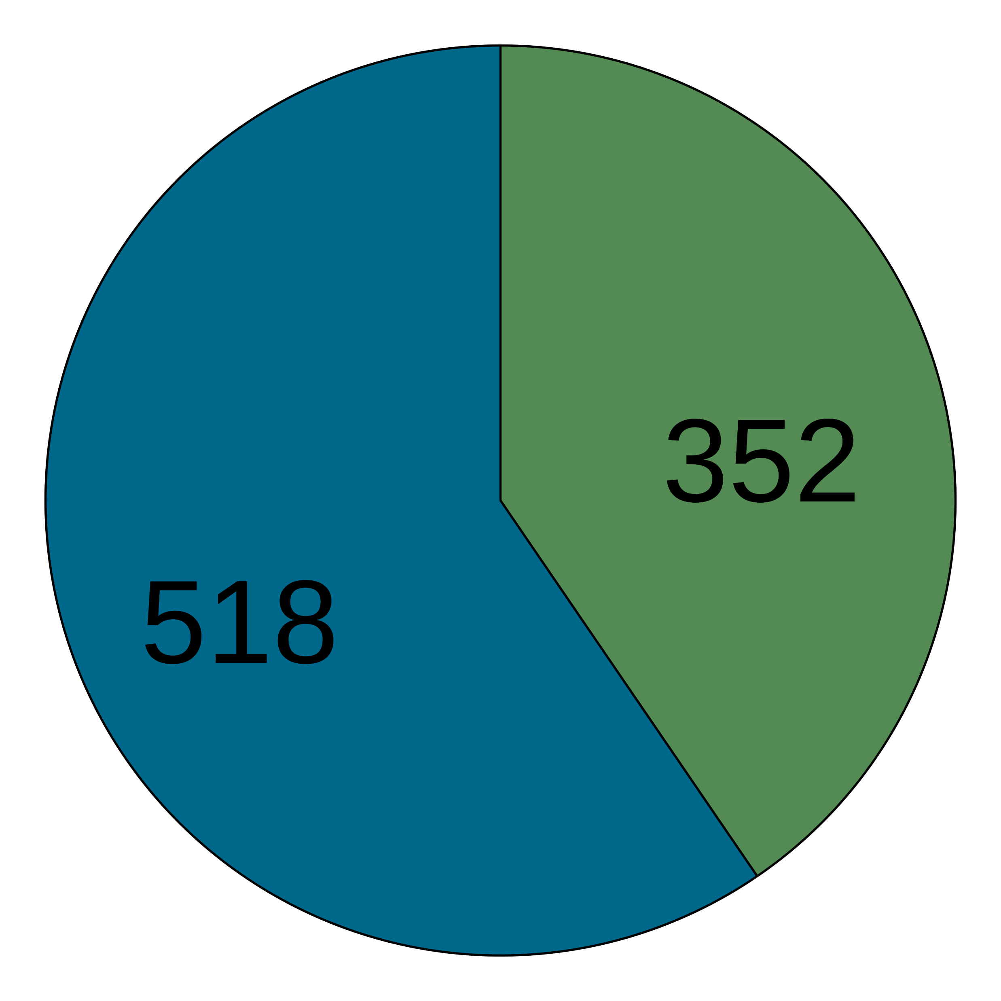
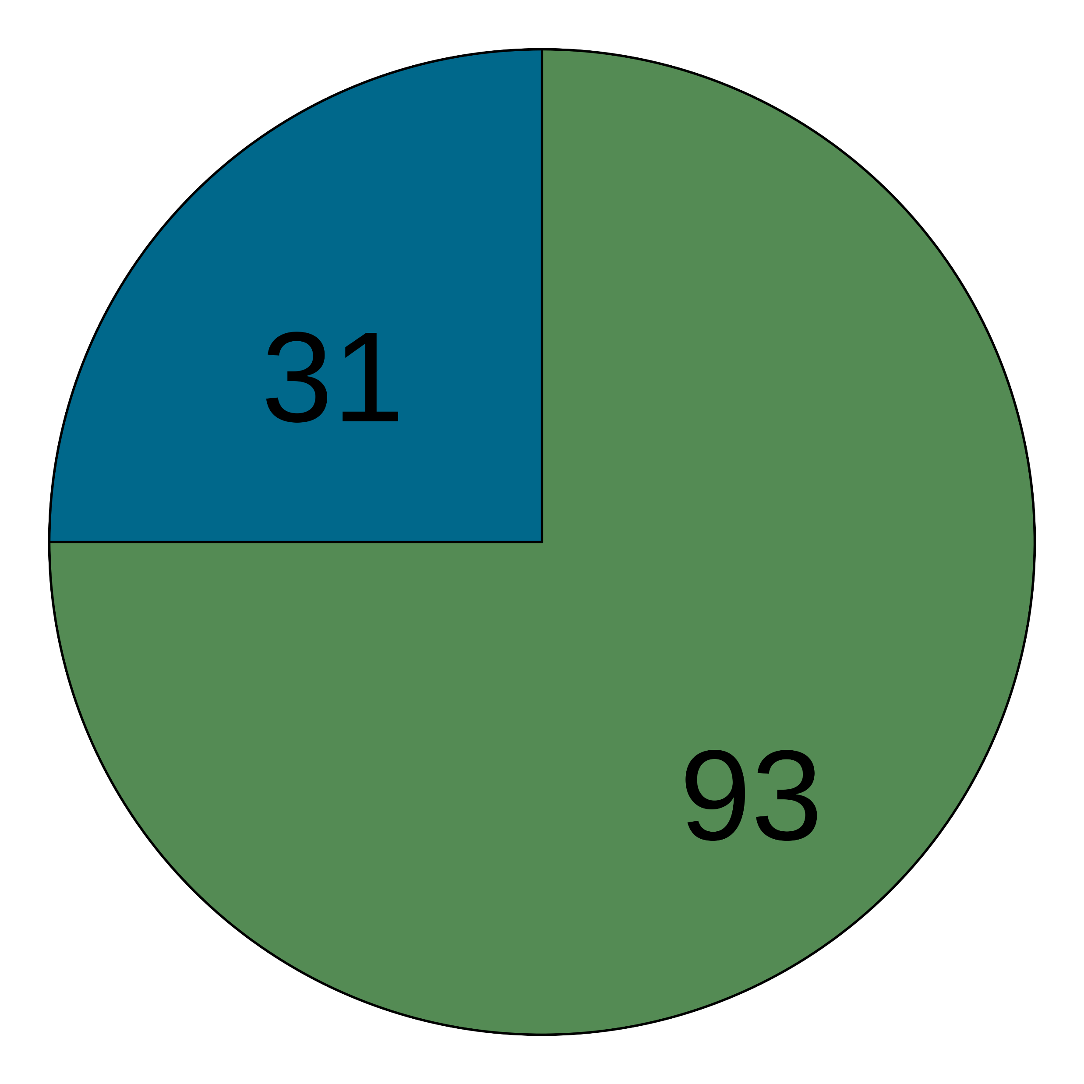
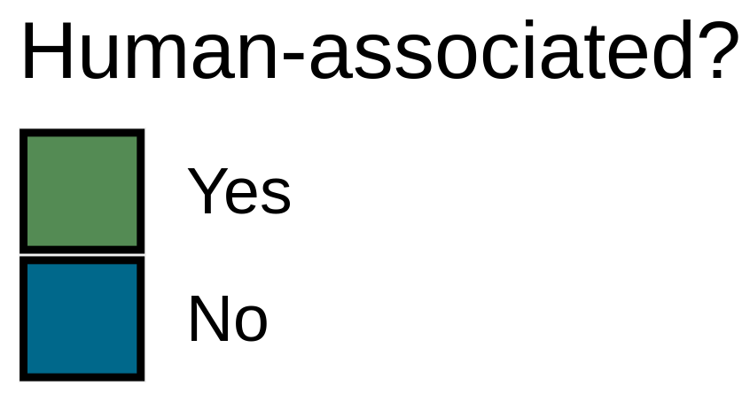
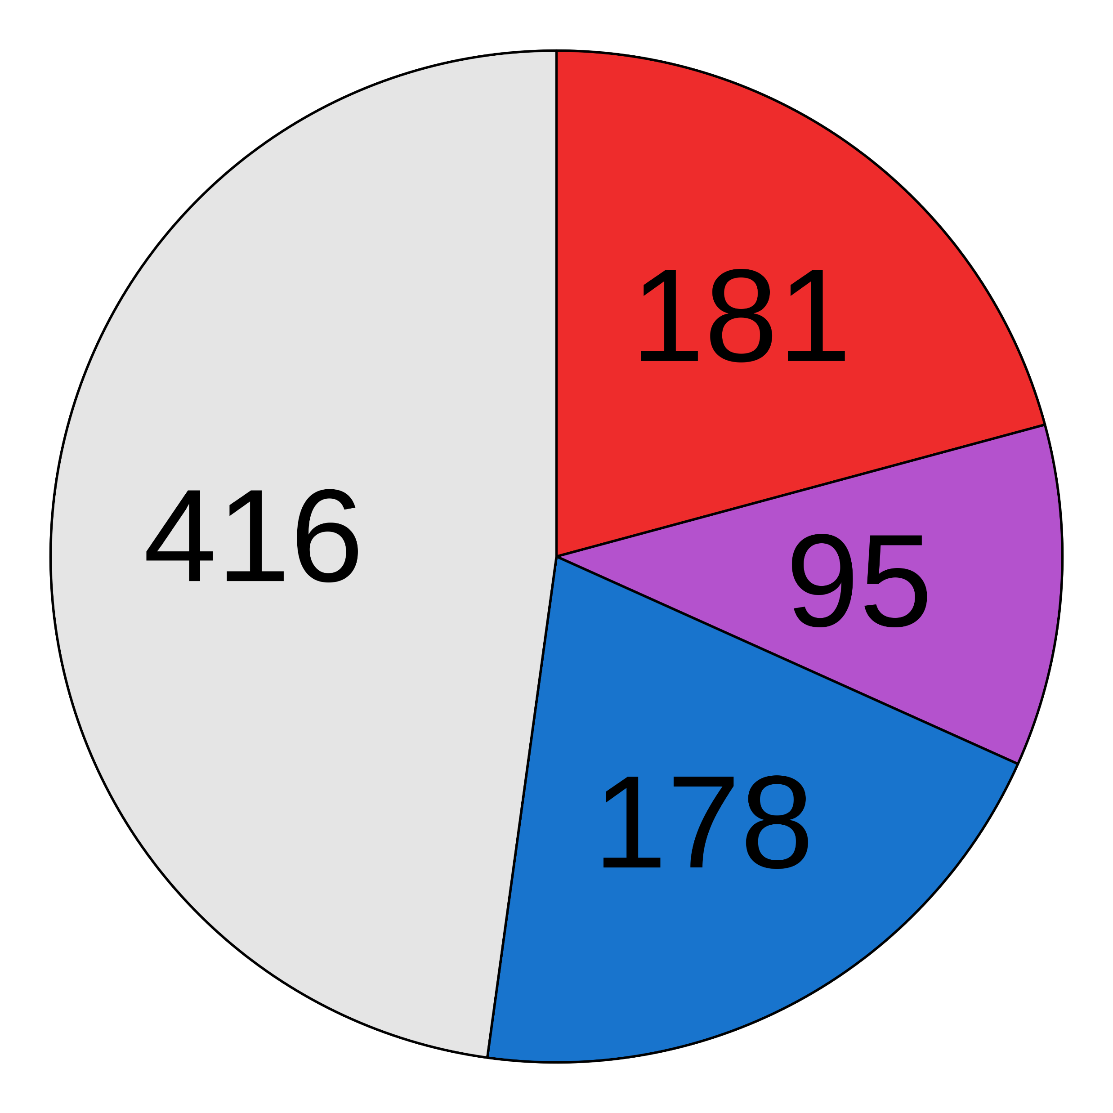
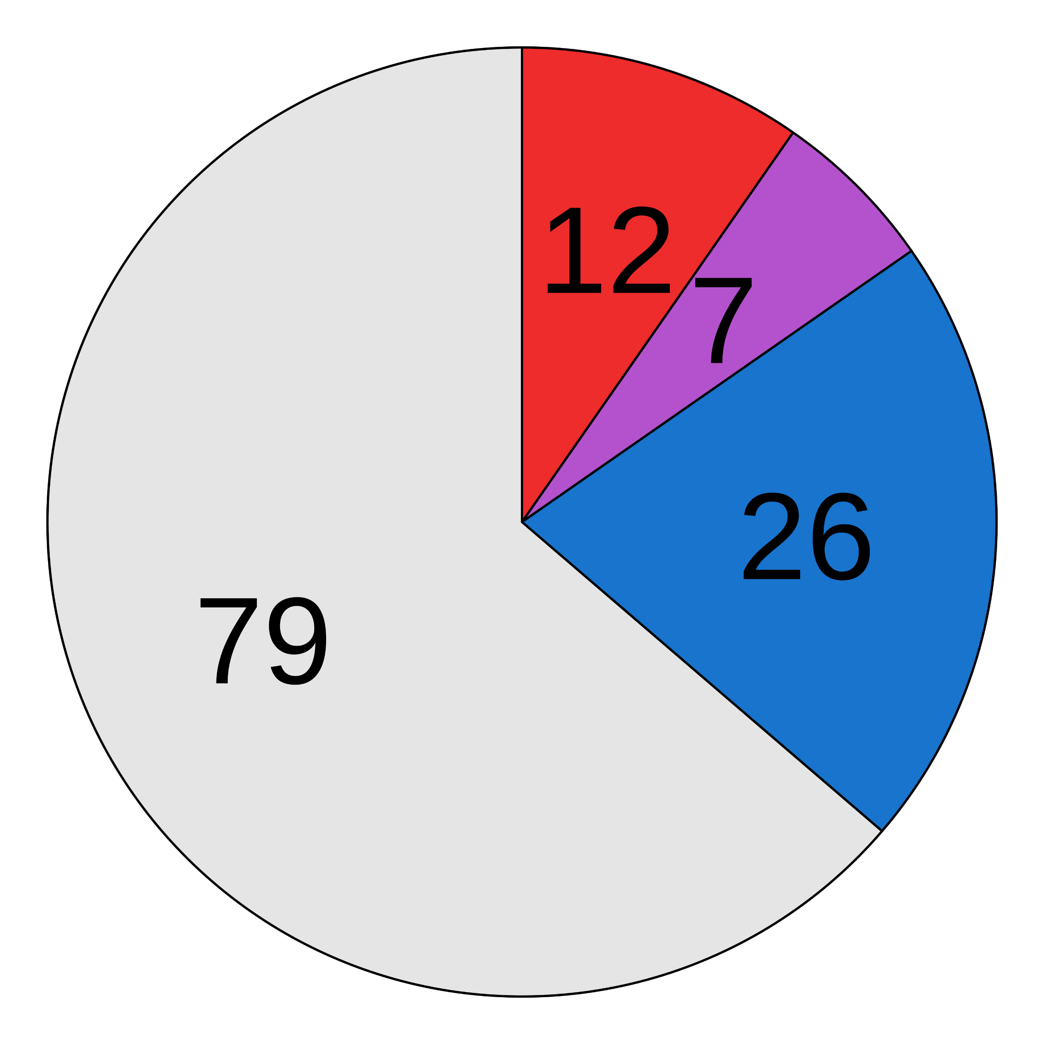
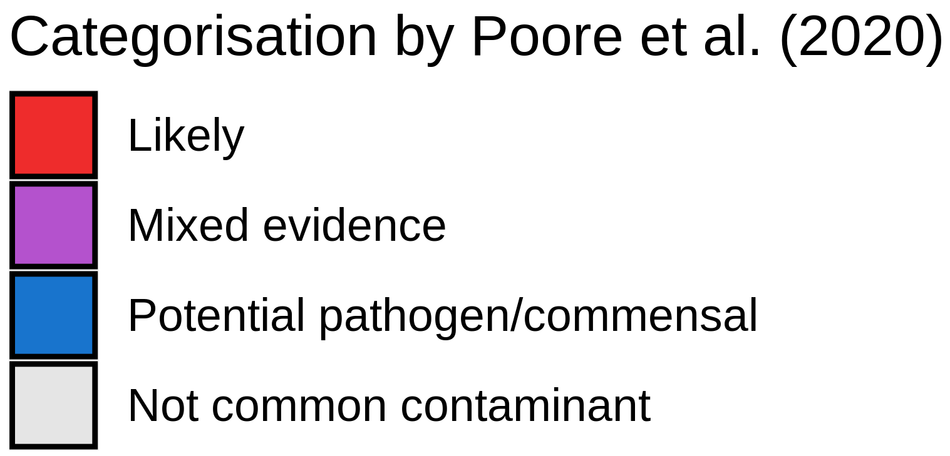
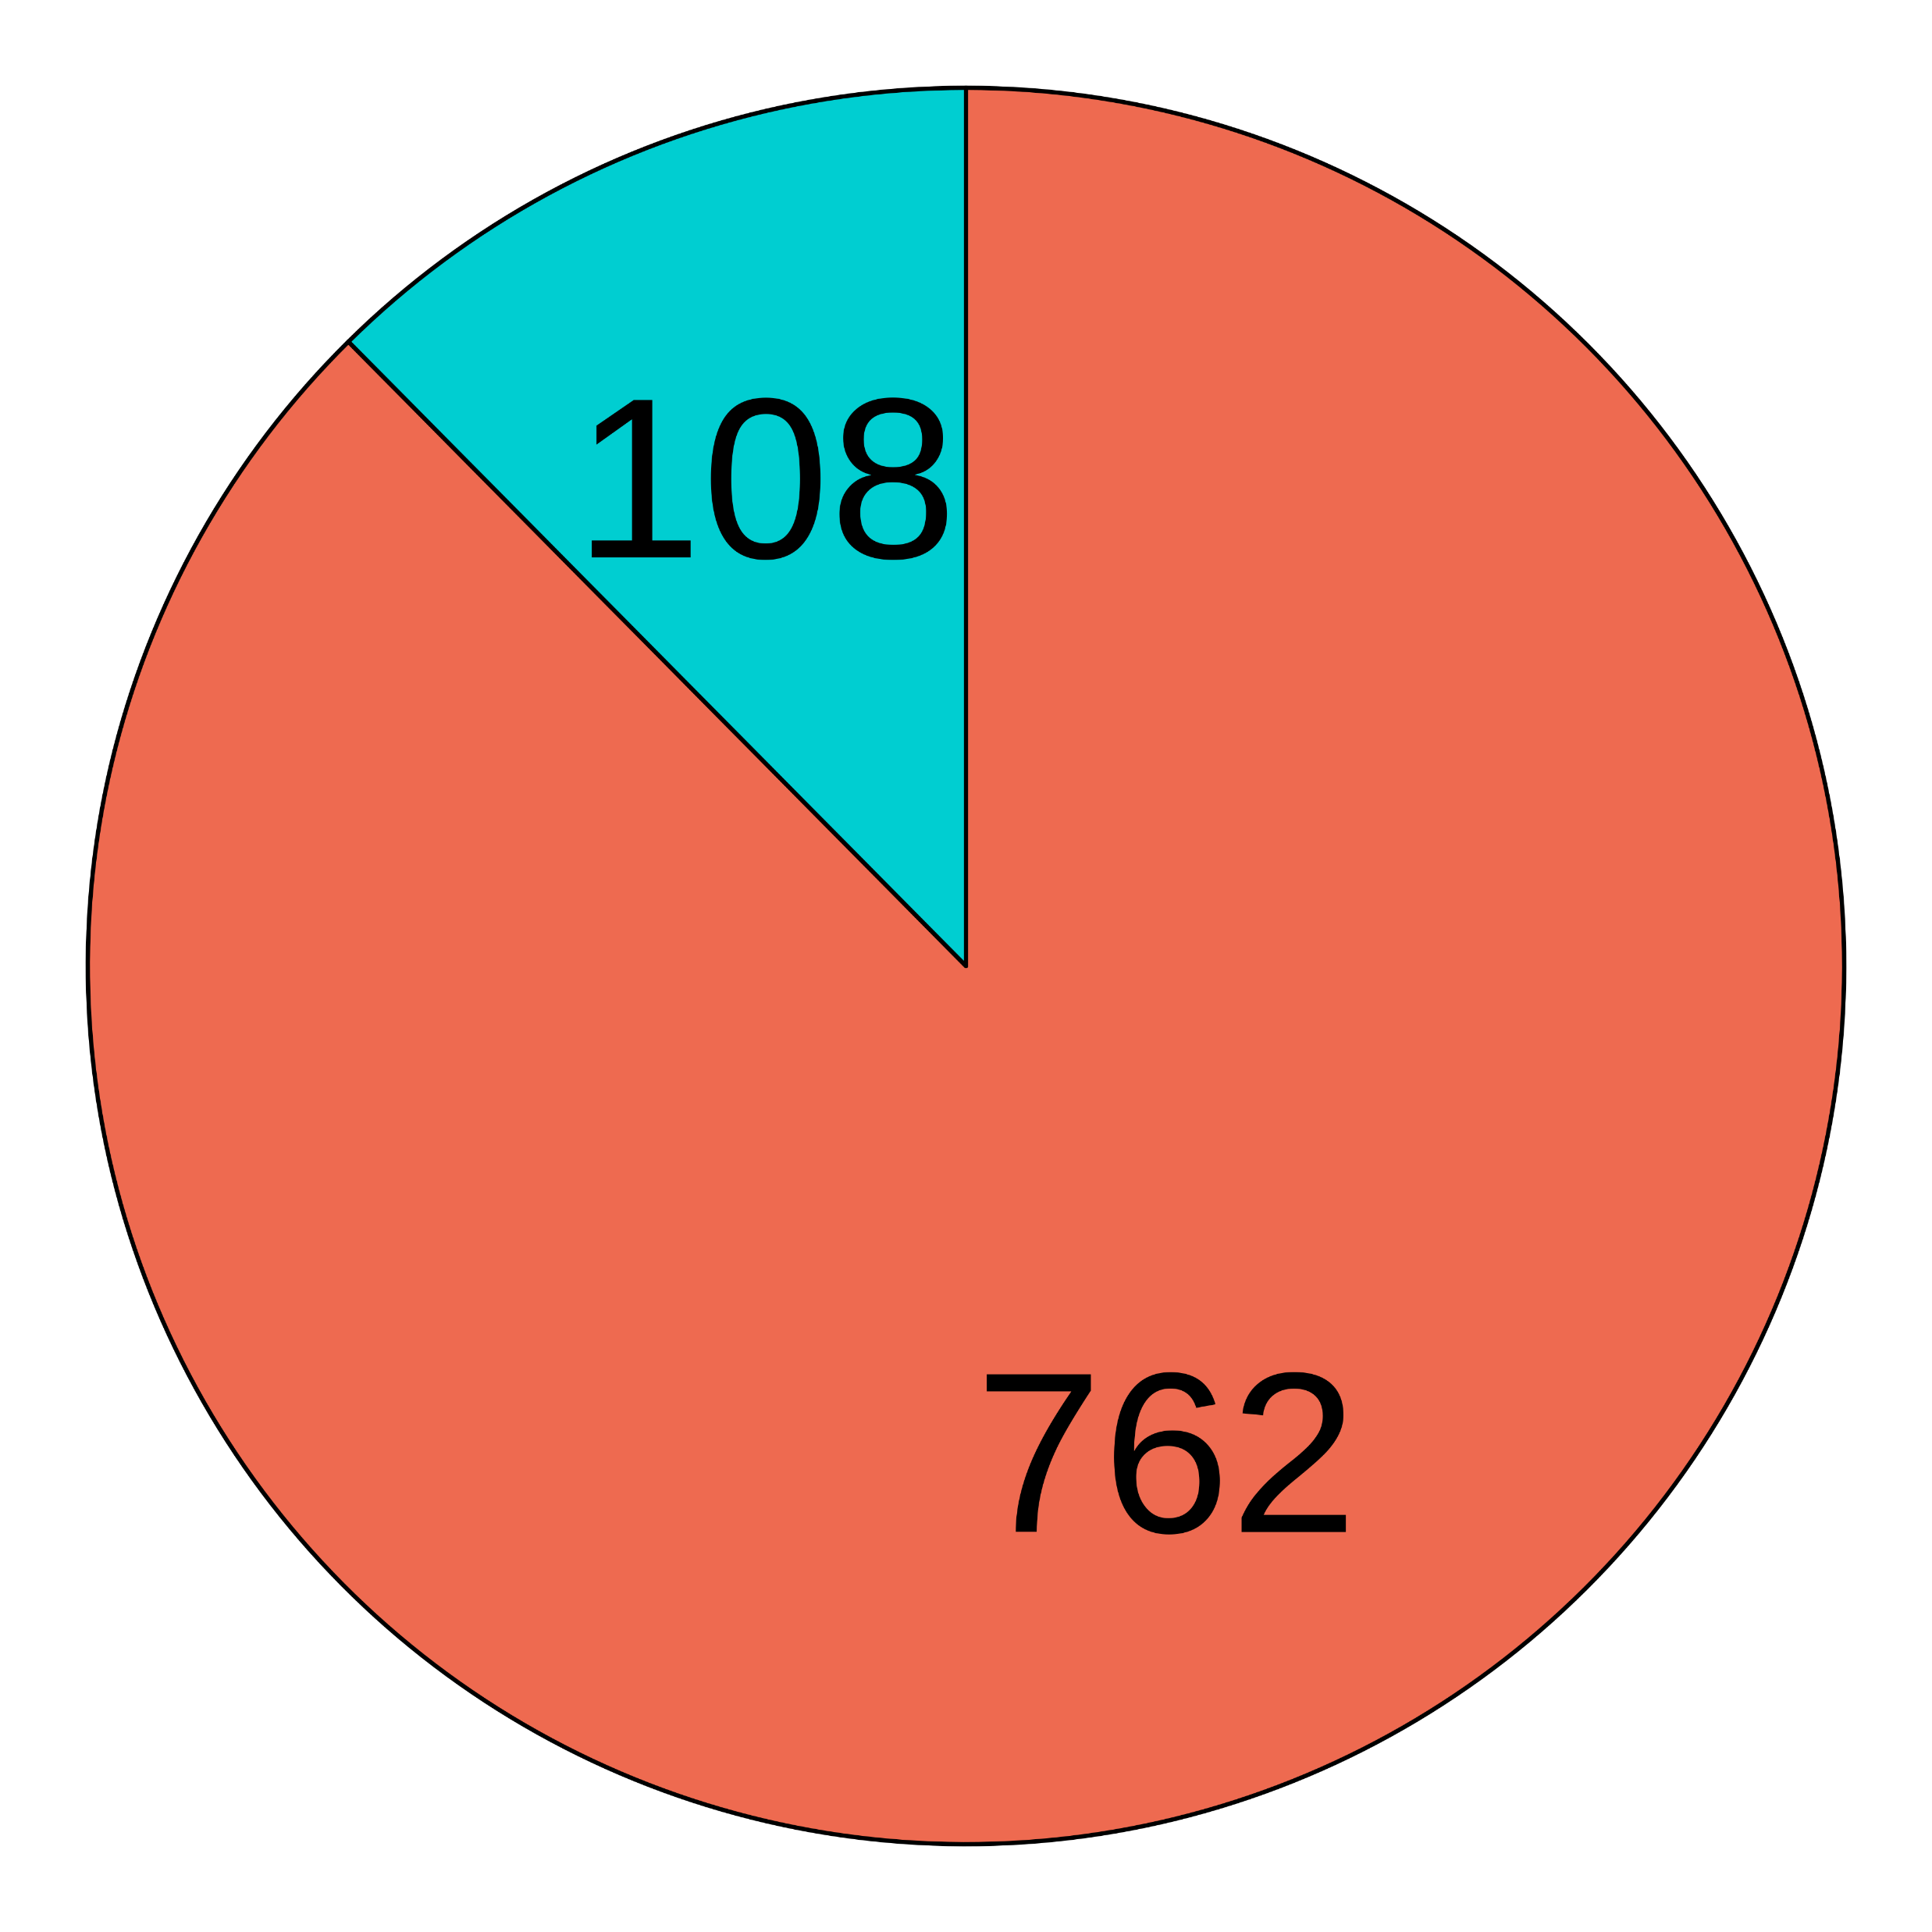
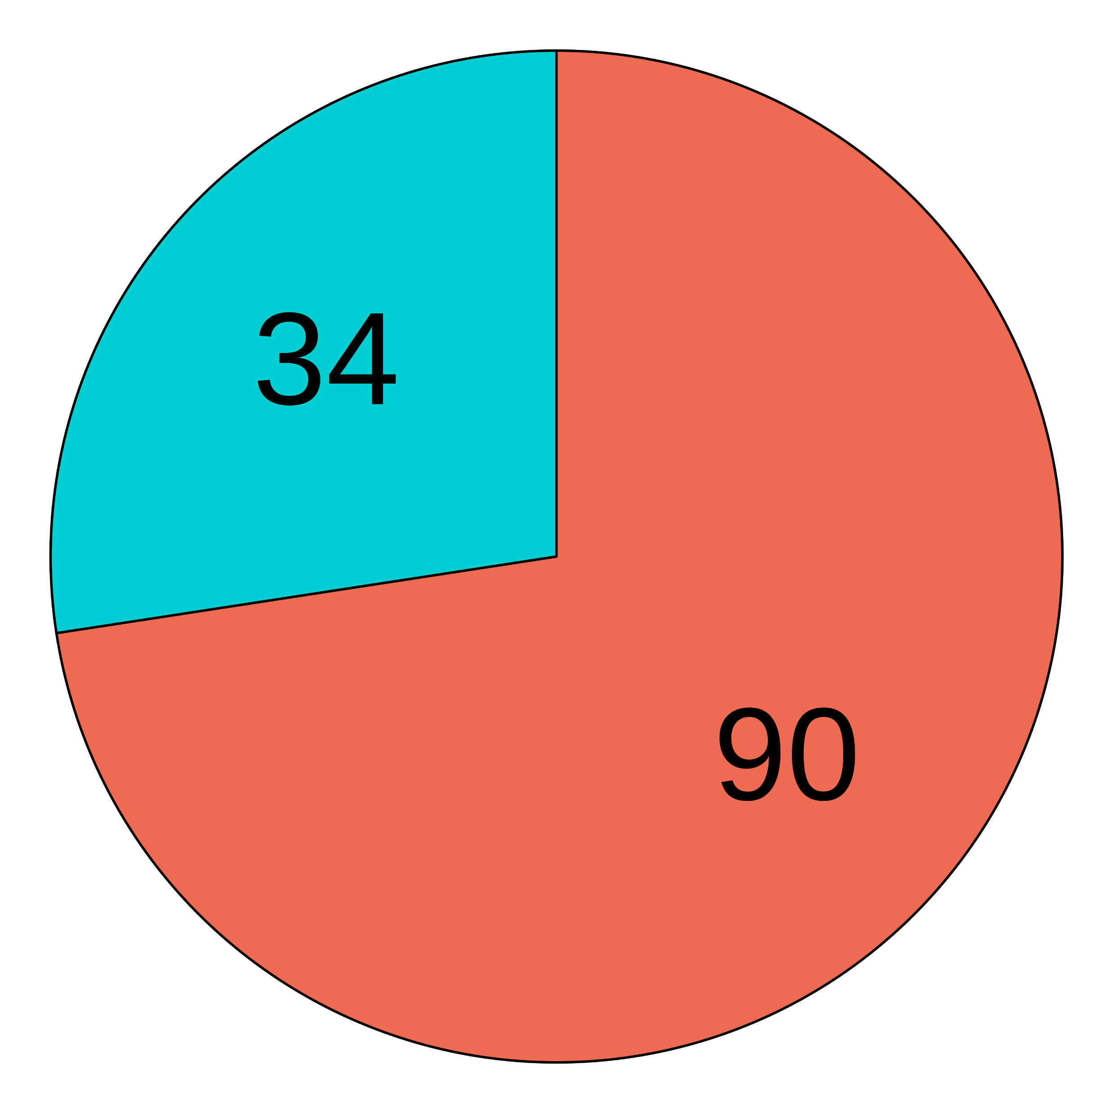
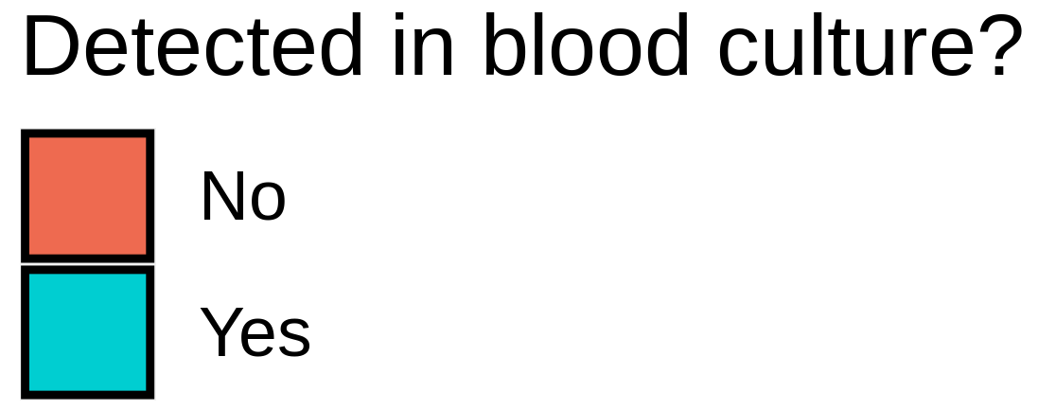
a
Remove GRCh38-mapped reads
Basic QC
Healthy blood metagenomes
n = 9706
1. Base quality trimming
2. Read quality filter
3. Low complexity read filter
n = 8828
8841 species
Remove samples with <100 microbial reads
n = 9706
8841 species
Kraken2 classification
Presence/absence filter
Prevalence filter
Correlation filter
Batch filter
Read count filter
Downstream analyses
871 species
710 species
535 species
190 species
124 species
Decontamination
Before decontamination
After decontamination
b
c
d
Notes:
Figure 1 → convince reader that I have eliminated most sources of error
Include sample sizes
Simplify filter descriptions (2-3 words)
BC records frequently/rarely
Stratification of culture reason

Slide 2
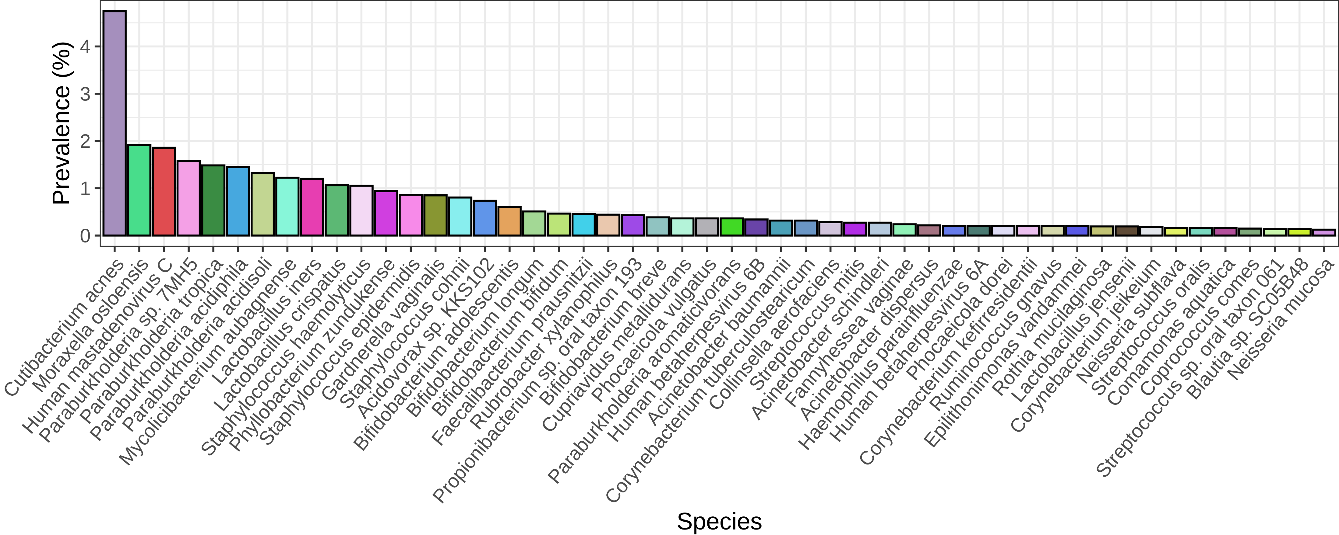
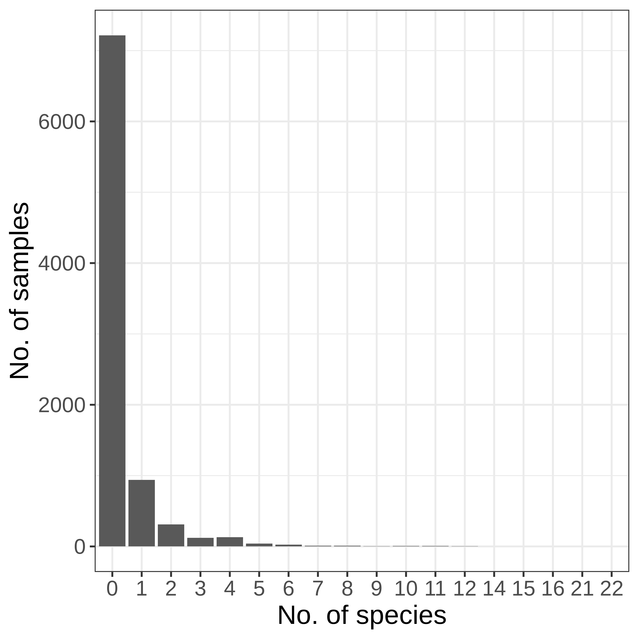
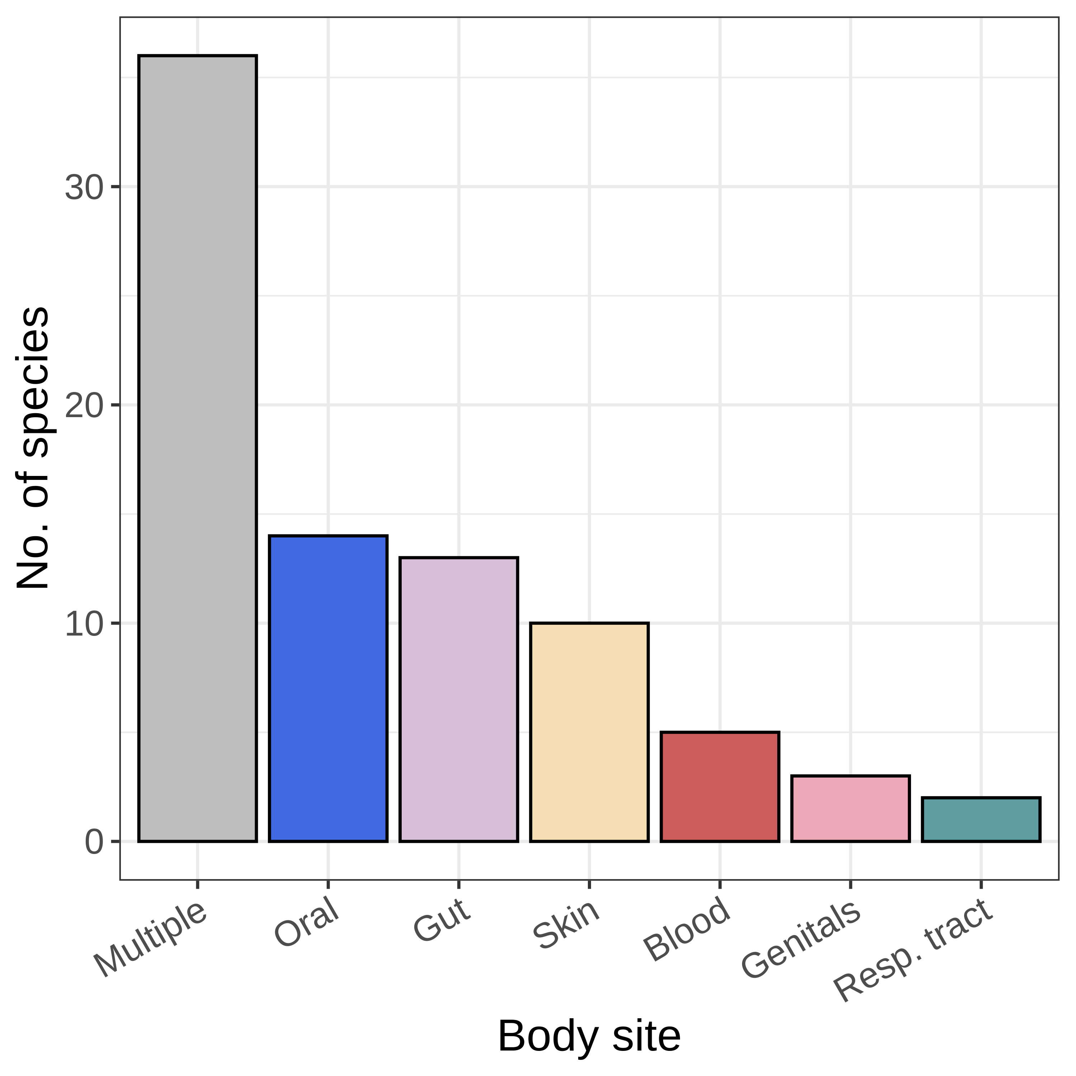
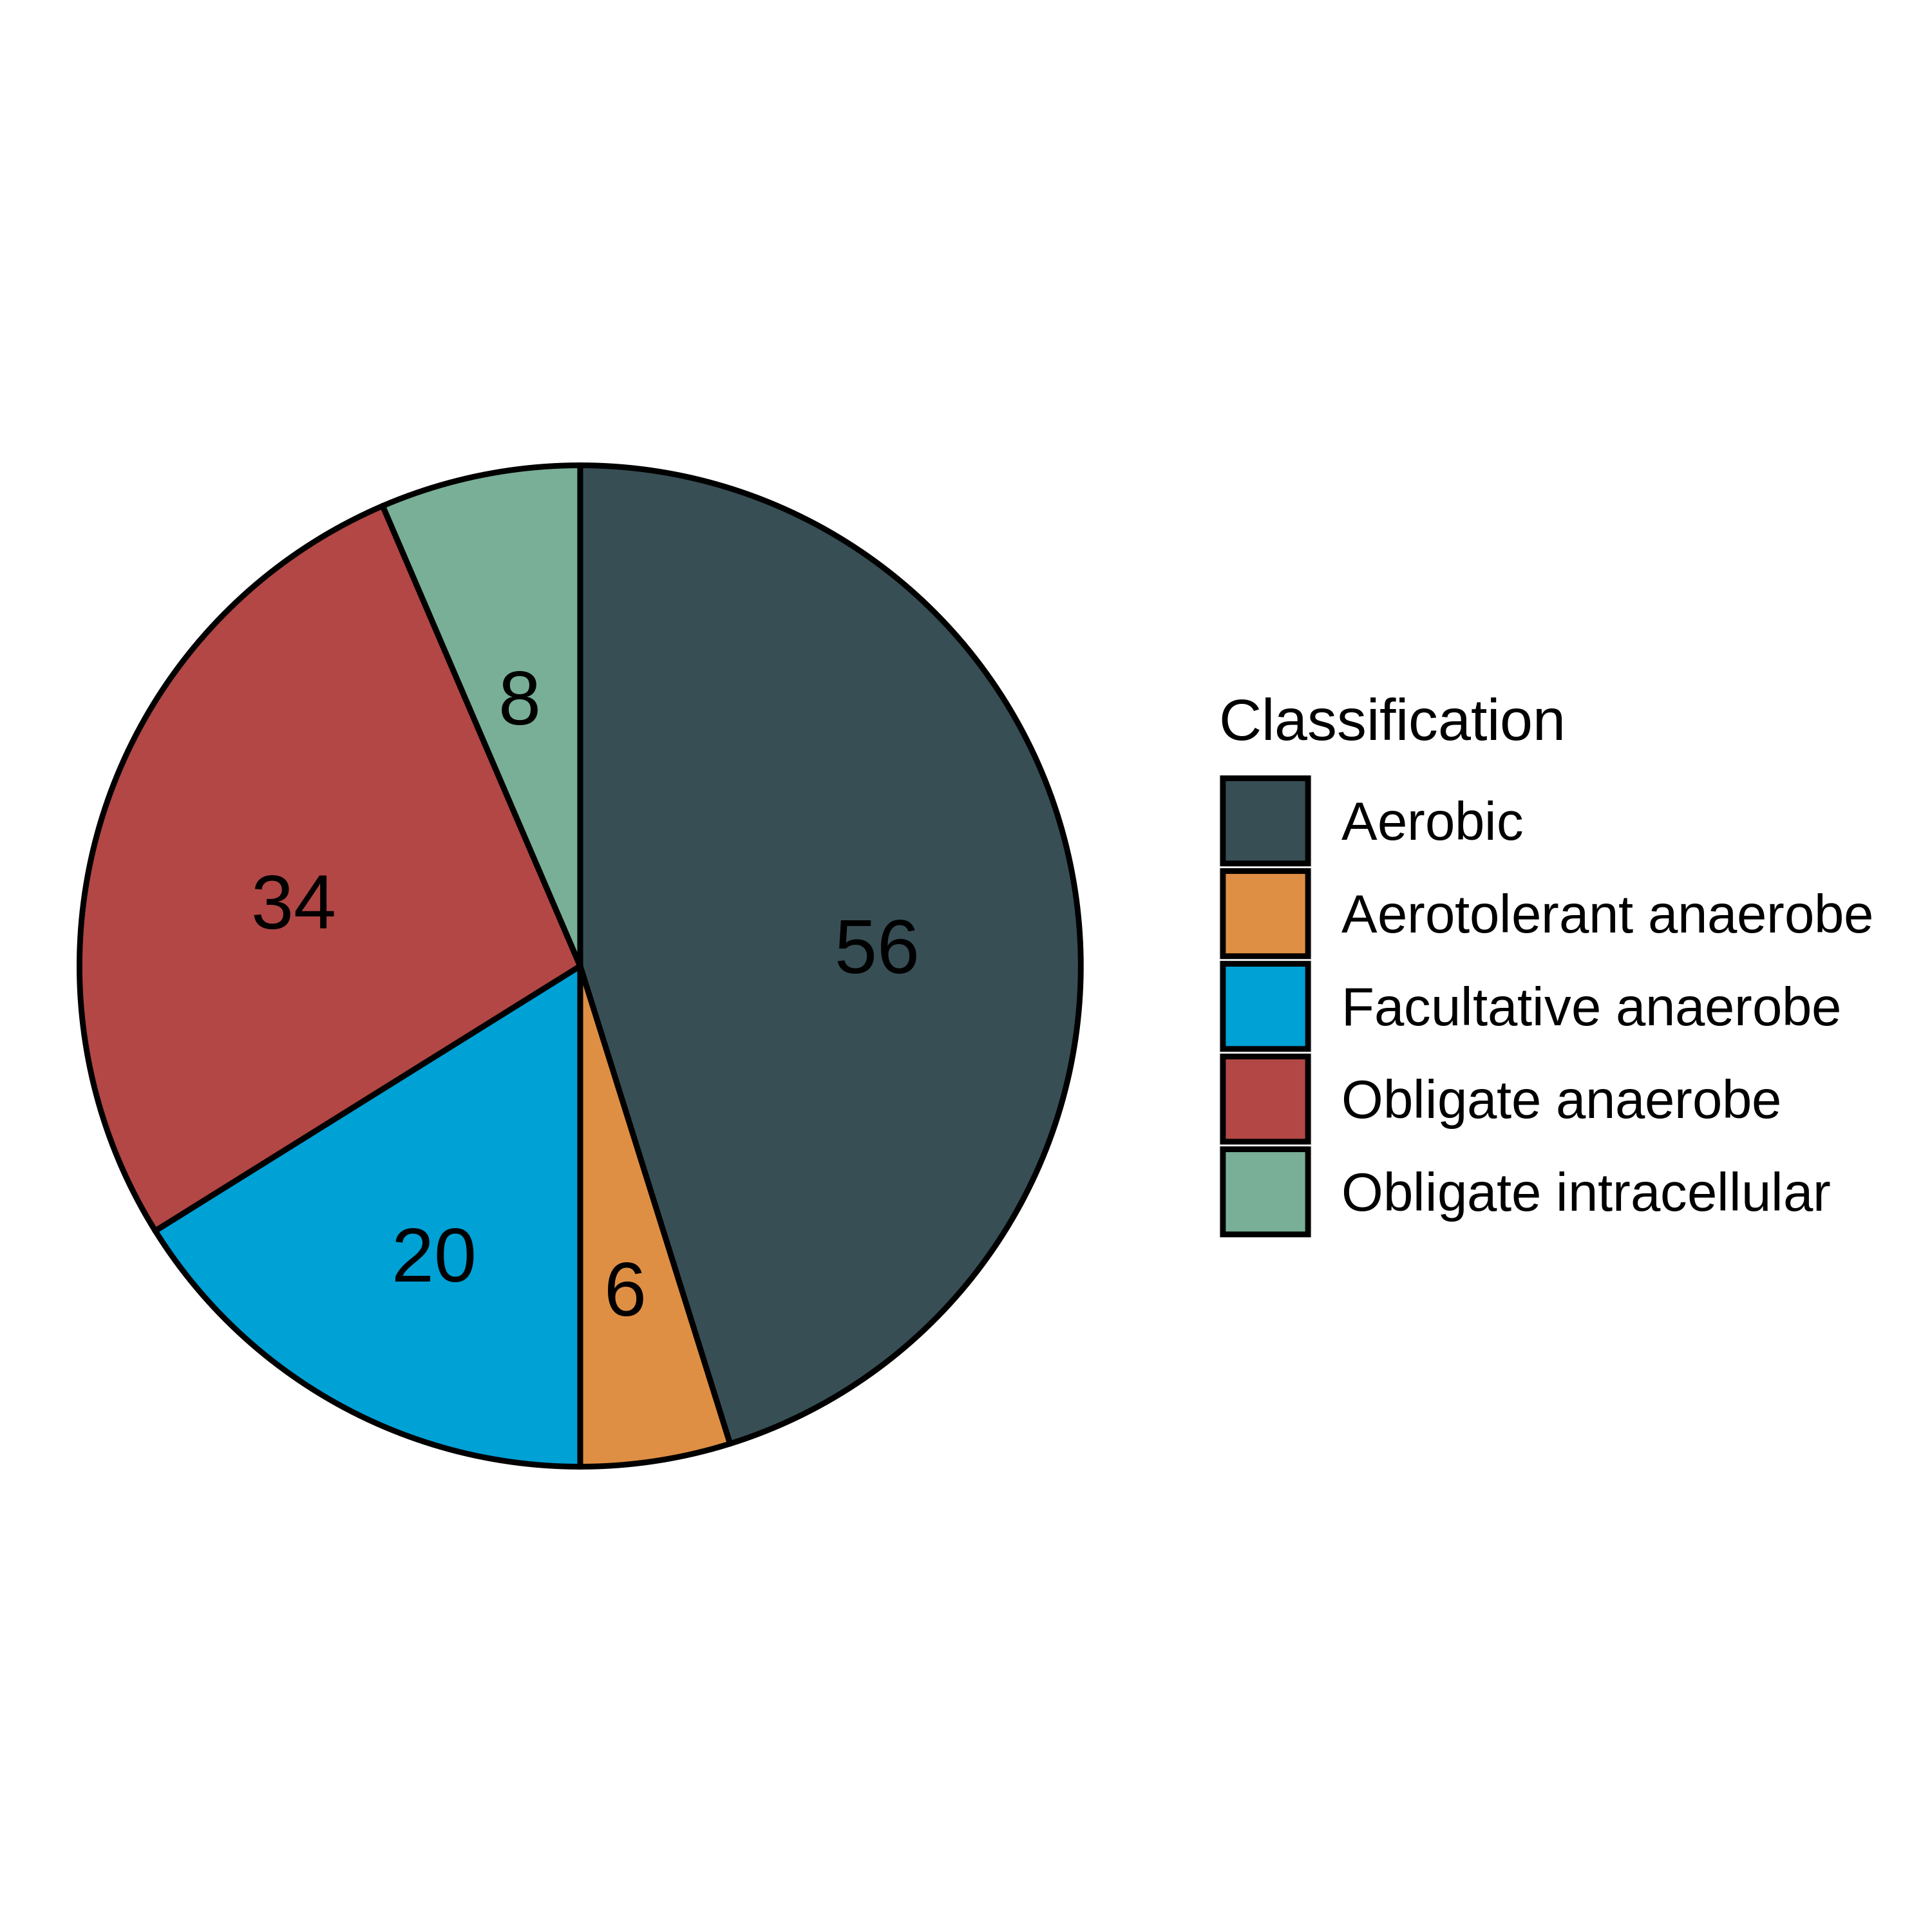
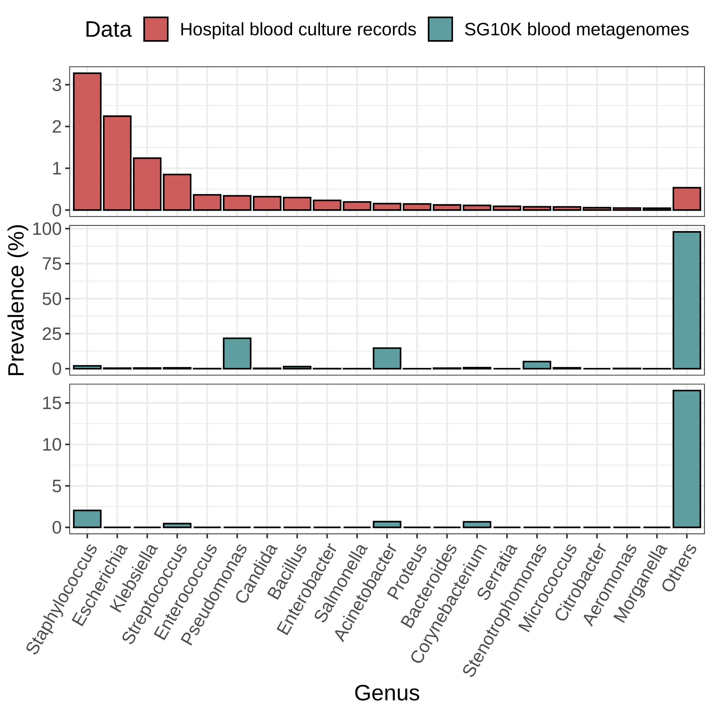
a
b
n = 8,828
c
d
e
e
n = 281,704
Before decontamination (n = 8,828)
After decontamination (n = 8,828)
Notes:
Figure 2

Slide 3
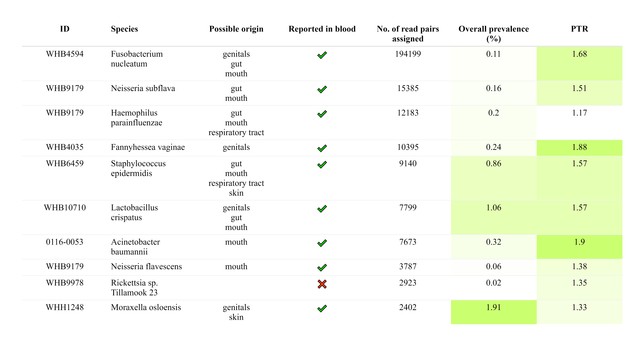
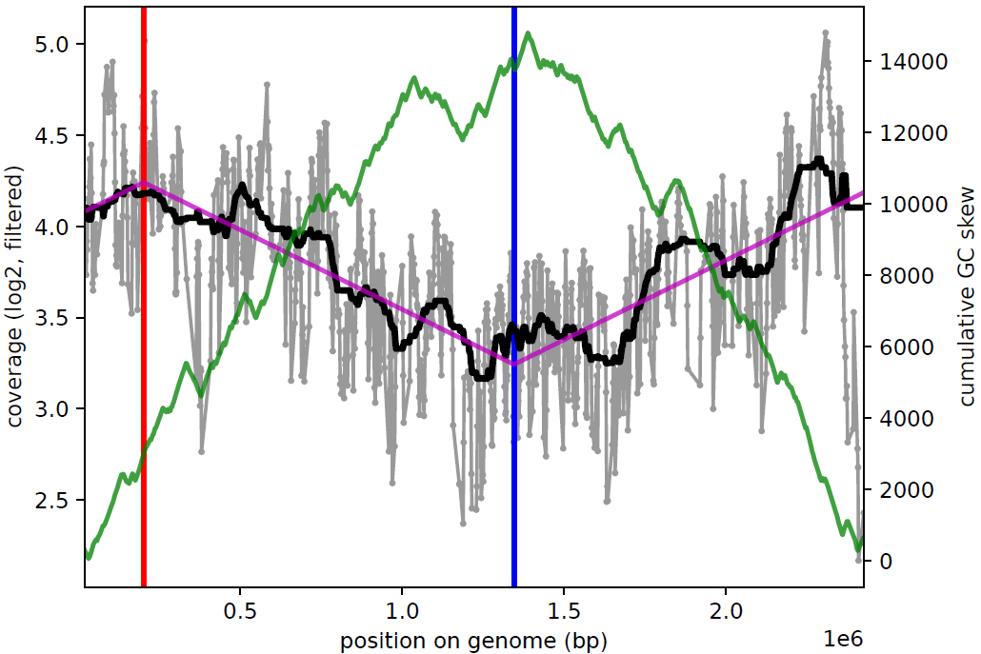
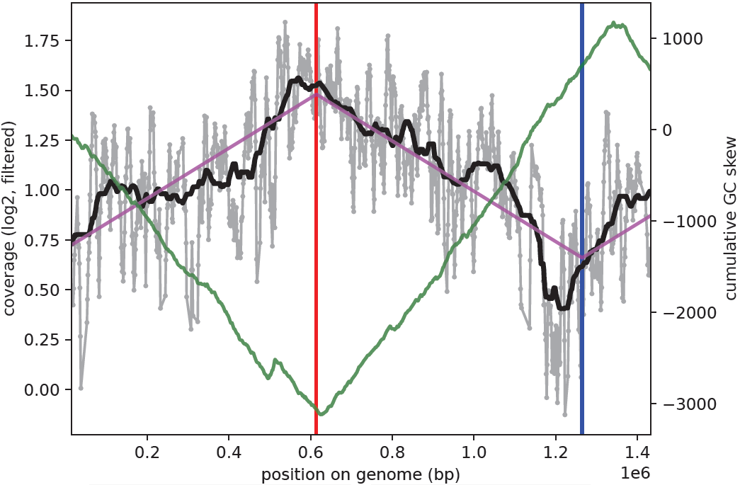
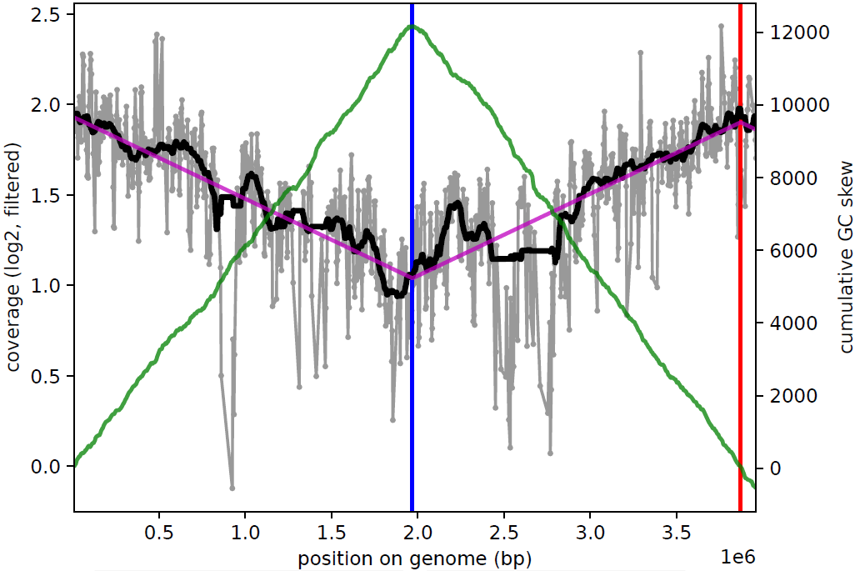
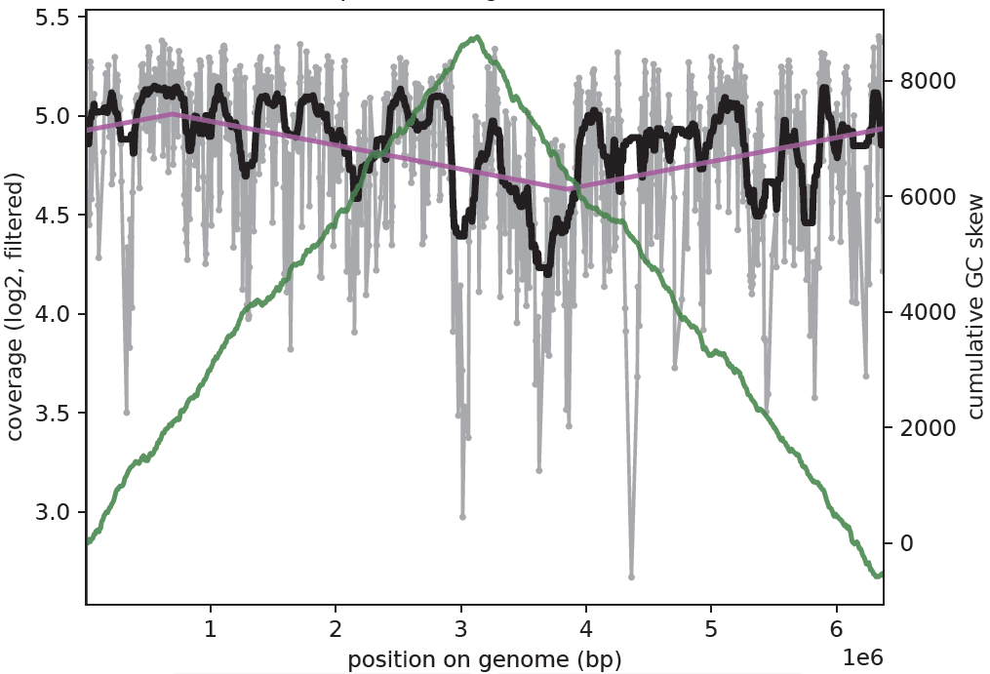
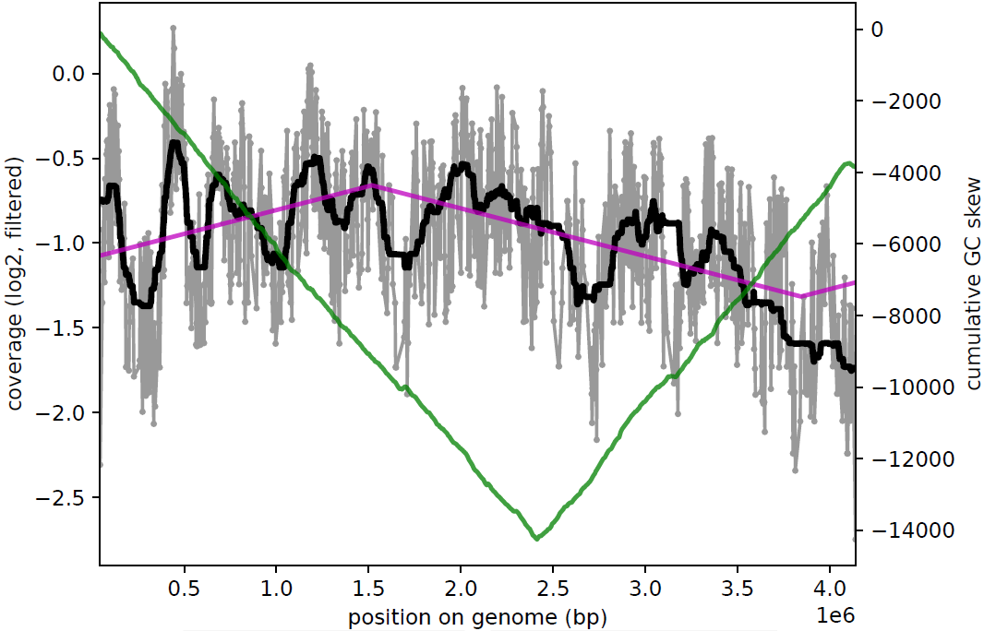
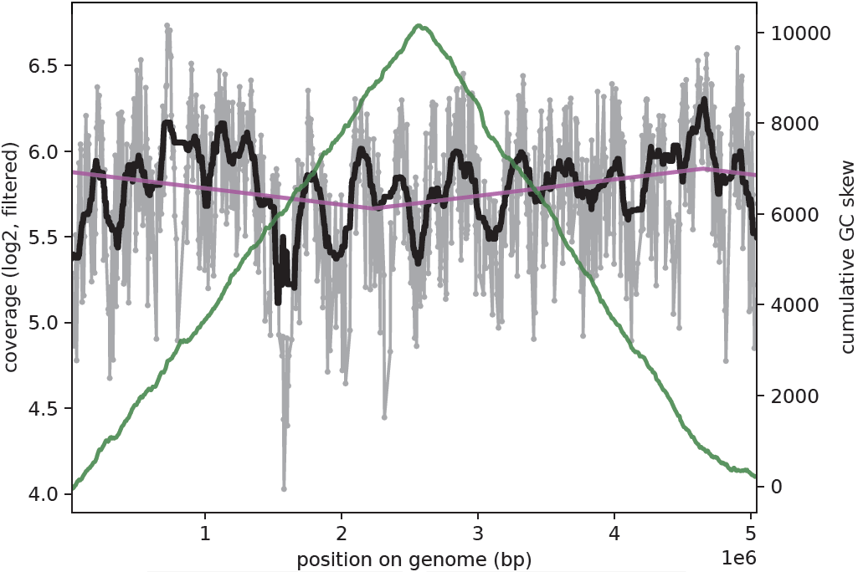
a
b
Non-contaminants
F. nucleatum
F. vaginae
A. baumannii
c
Contaminants
A. xylosoxidans
A. faecalis
P. mendocina
Legend
Coverage
Ori
Median smoothing
GC skew
Ter
Least squares fit
Notes:
Figure 3 GROUPED
Median smoothing
Multiplot this (2x2)
We have helios skin data

Slide 4
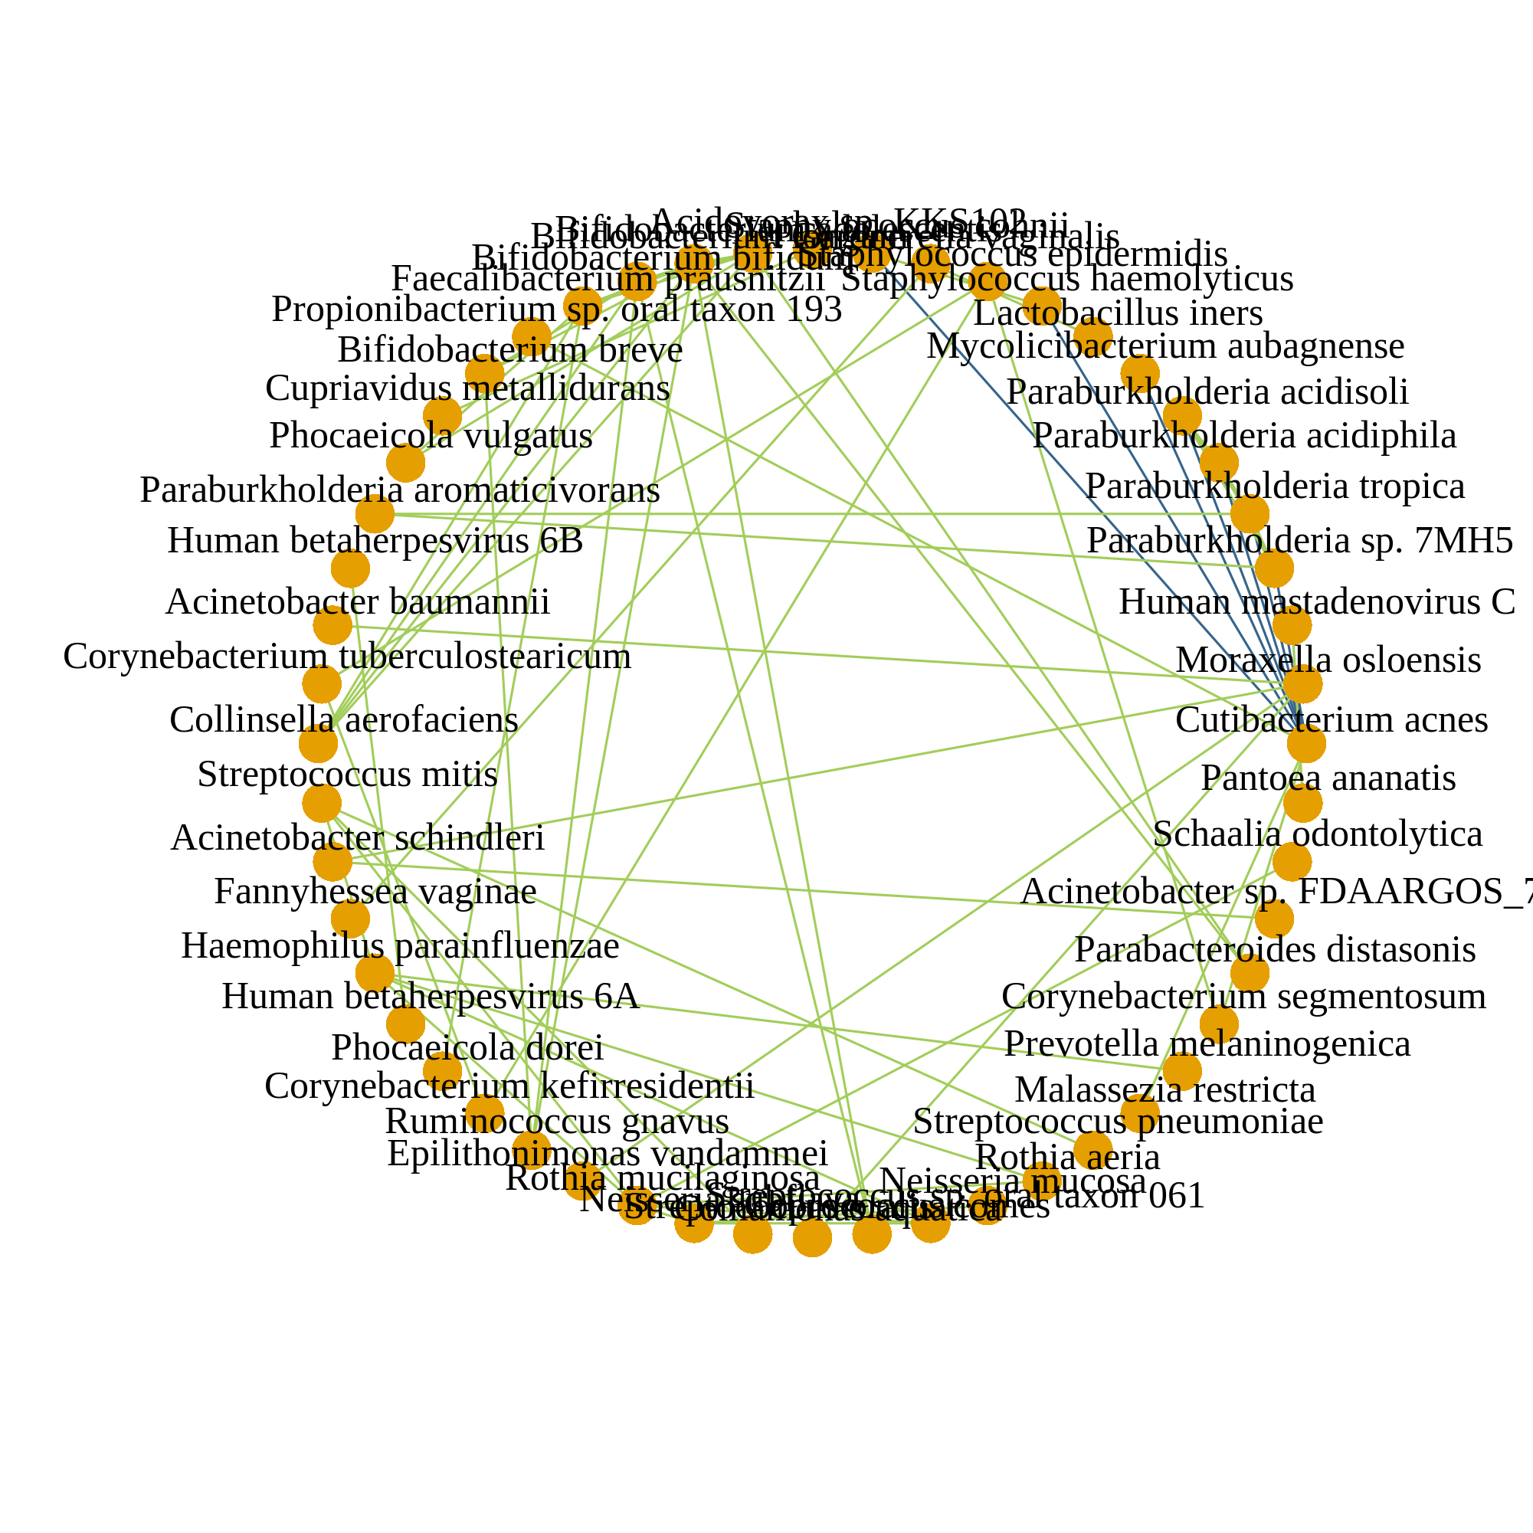
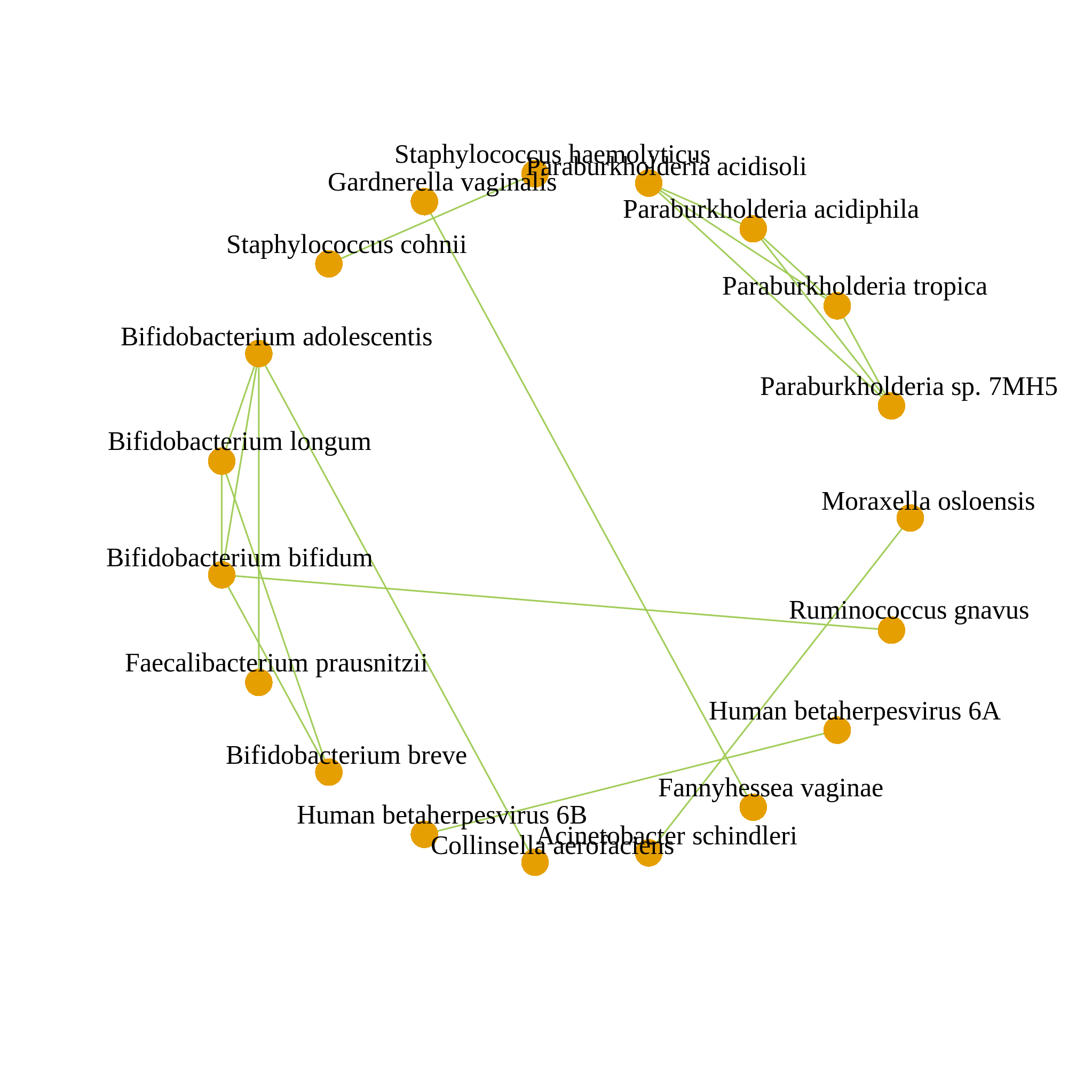
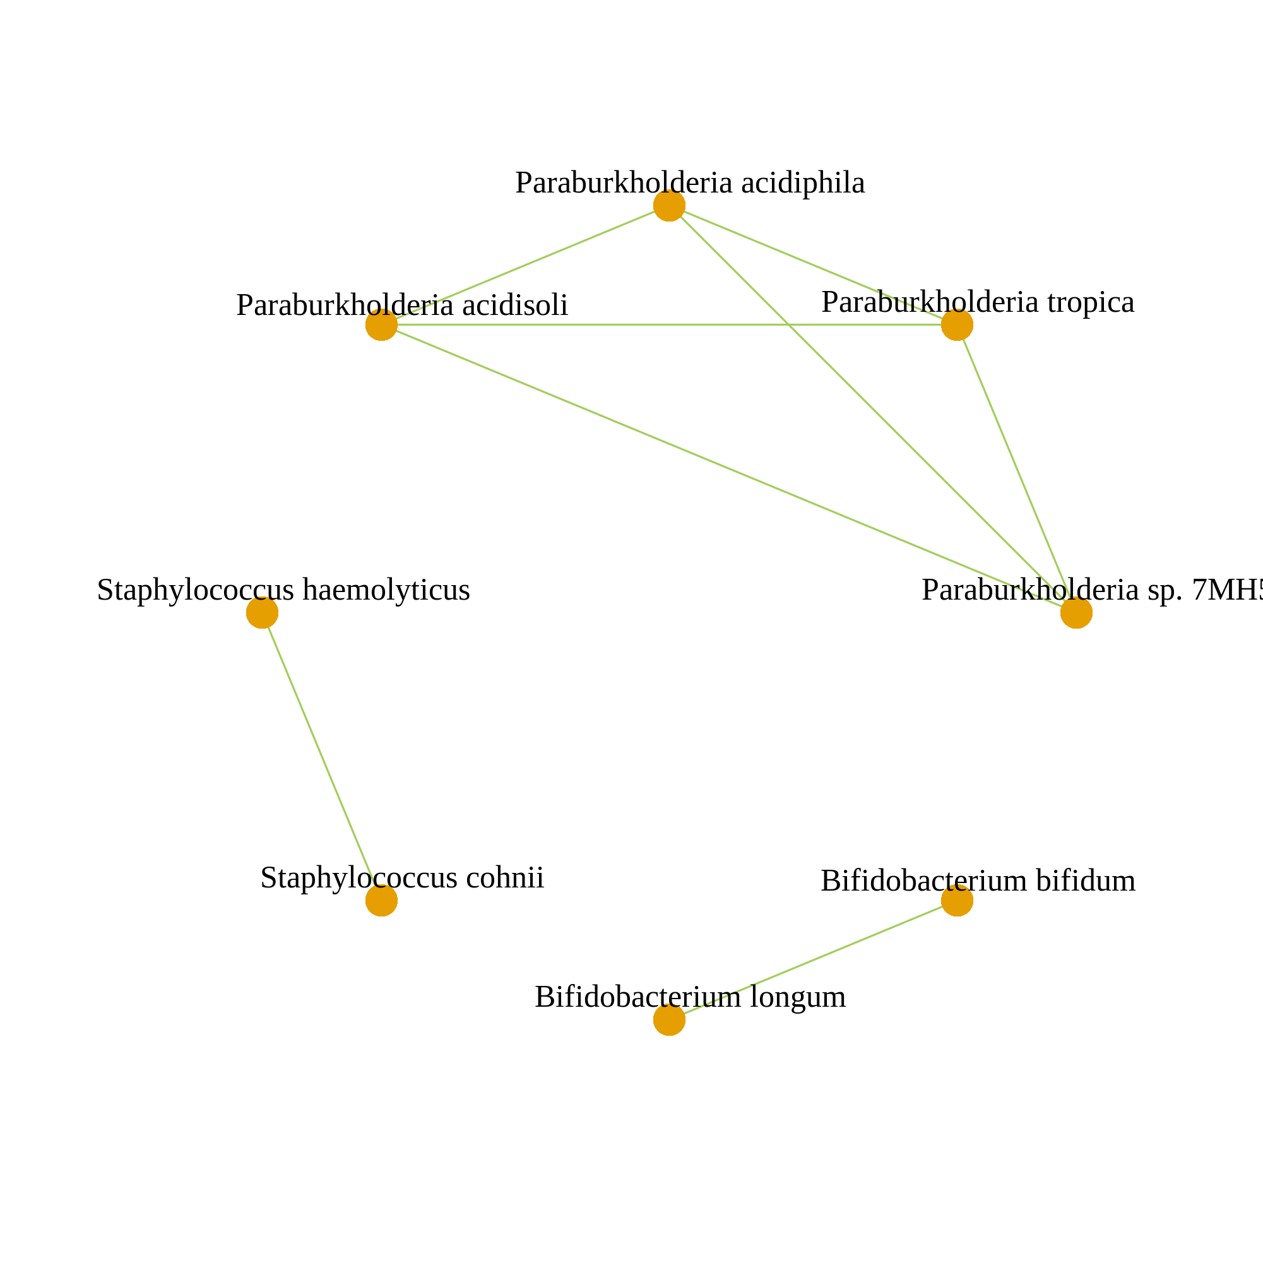
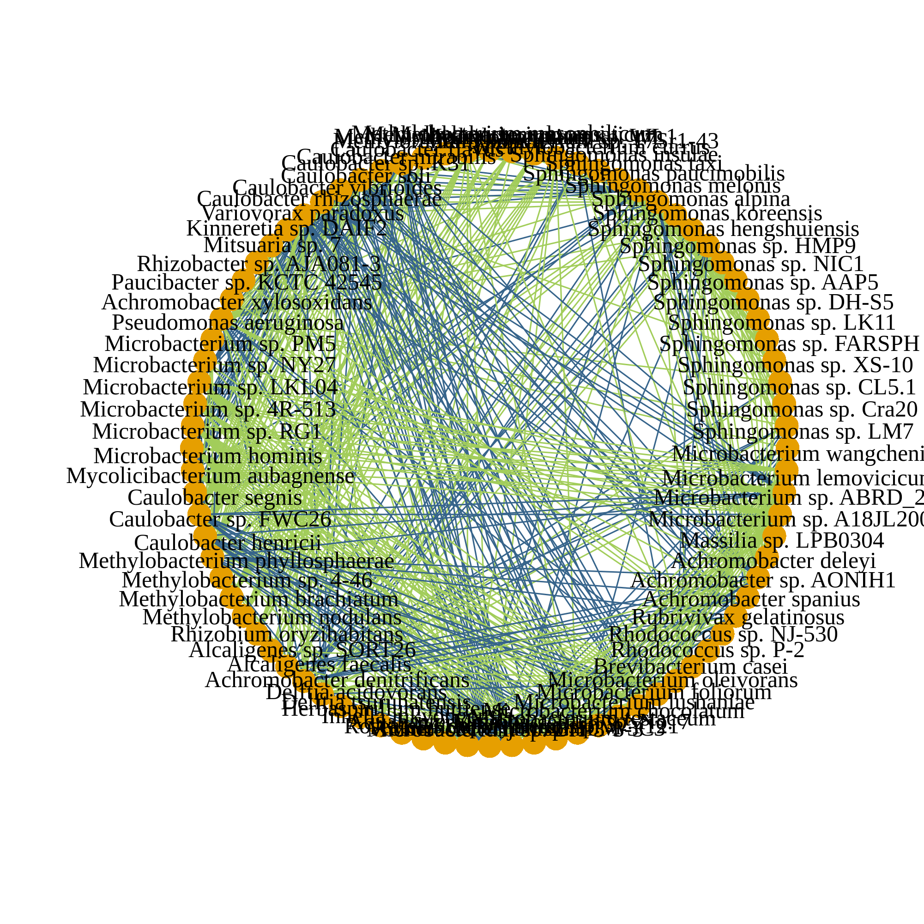
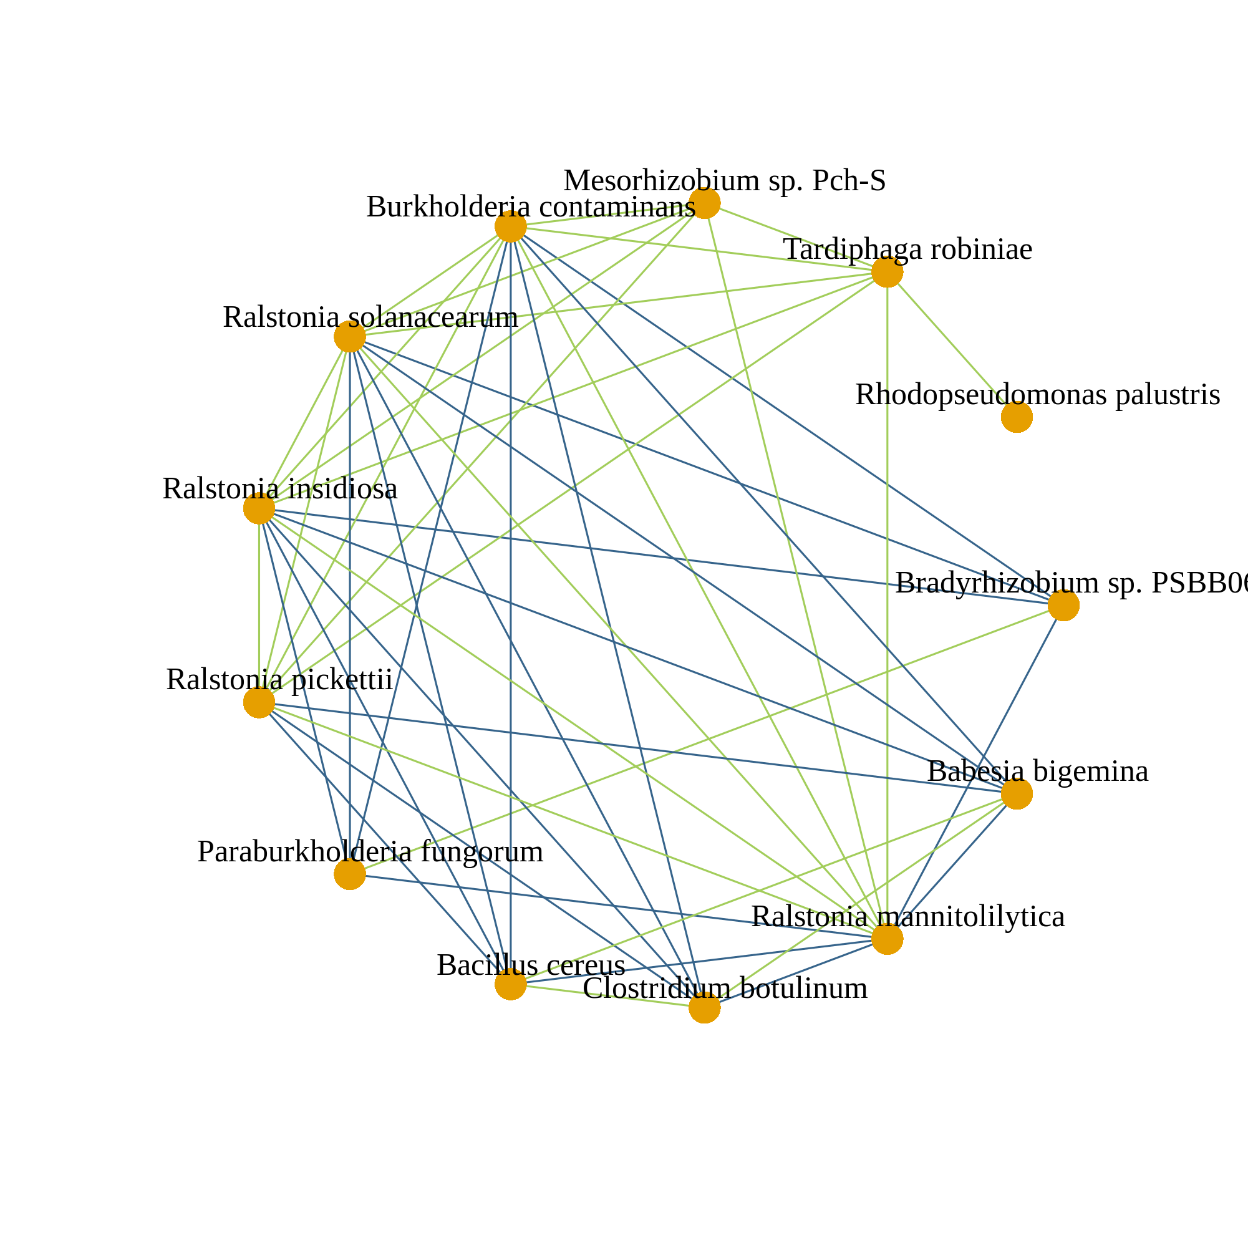
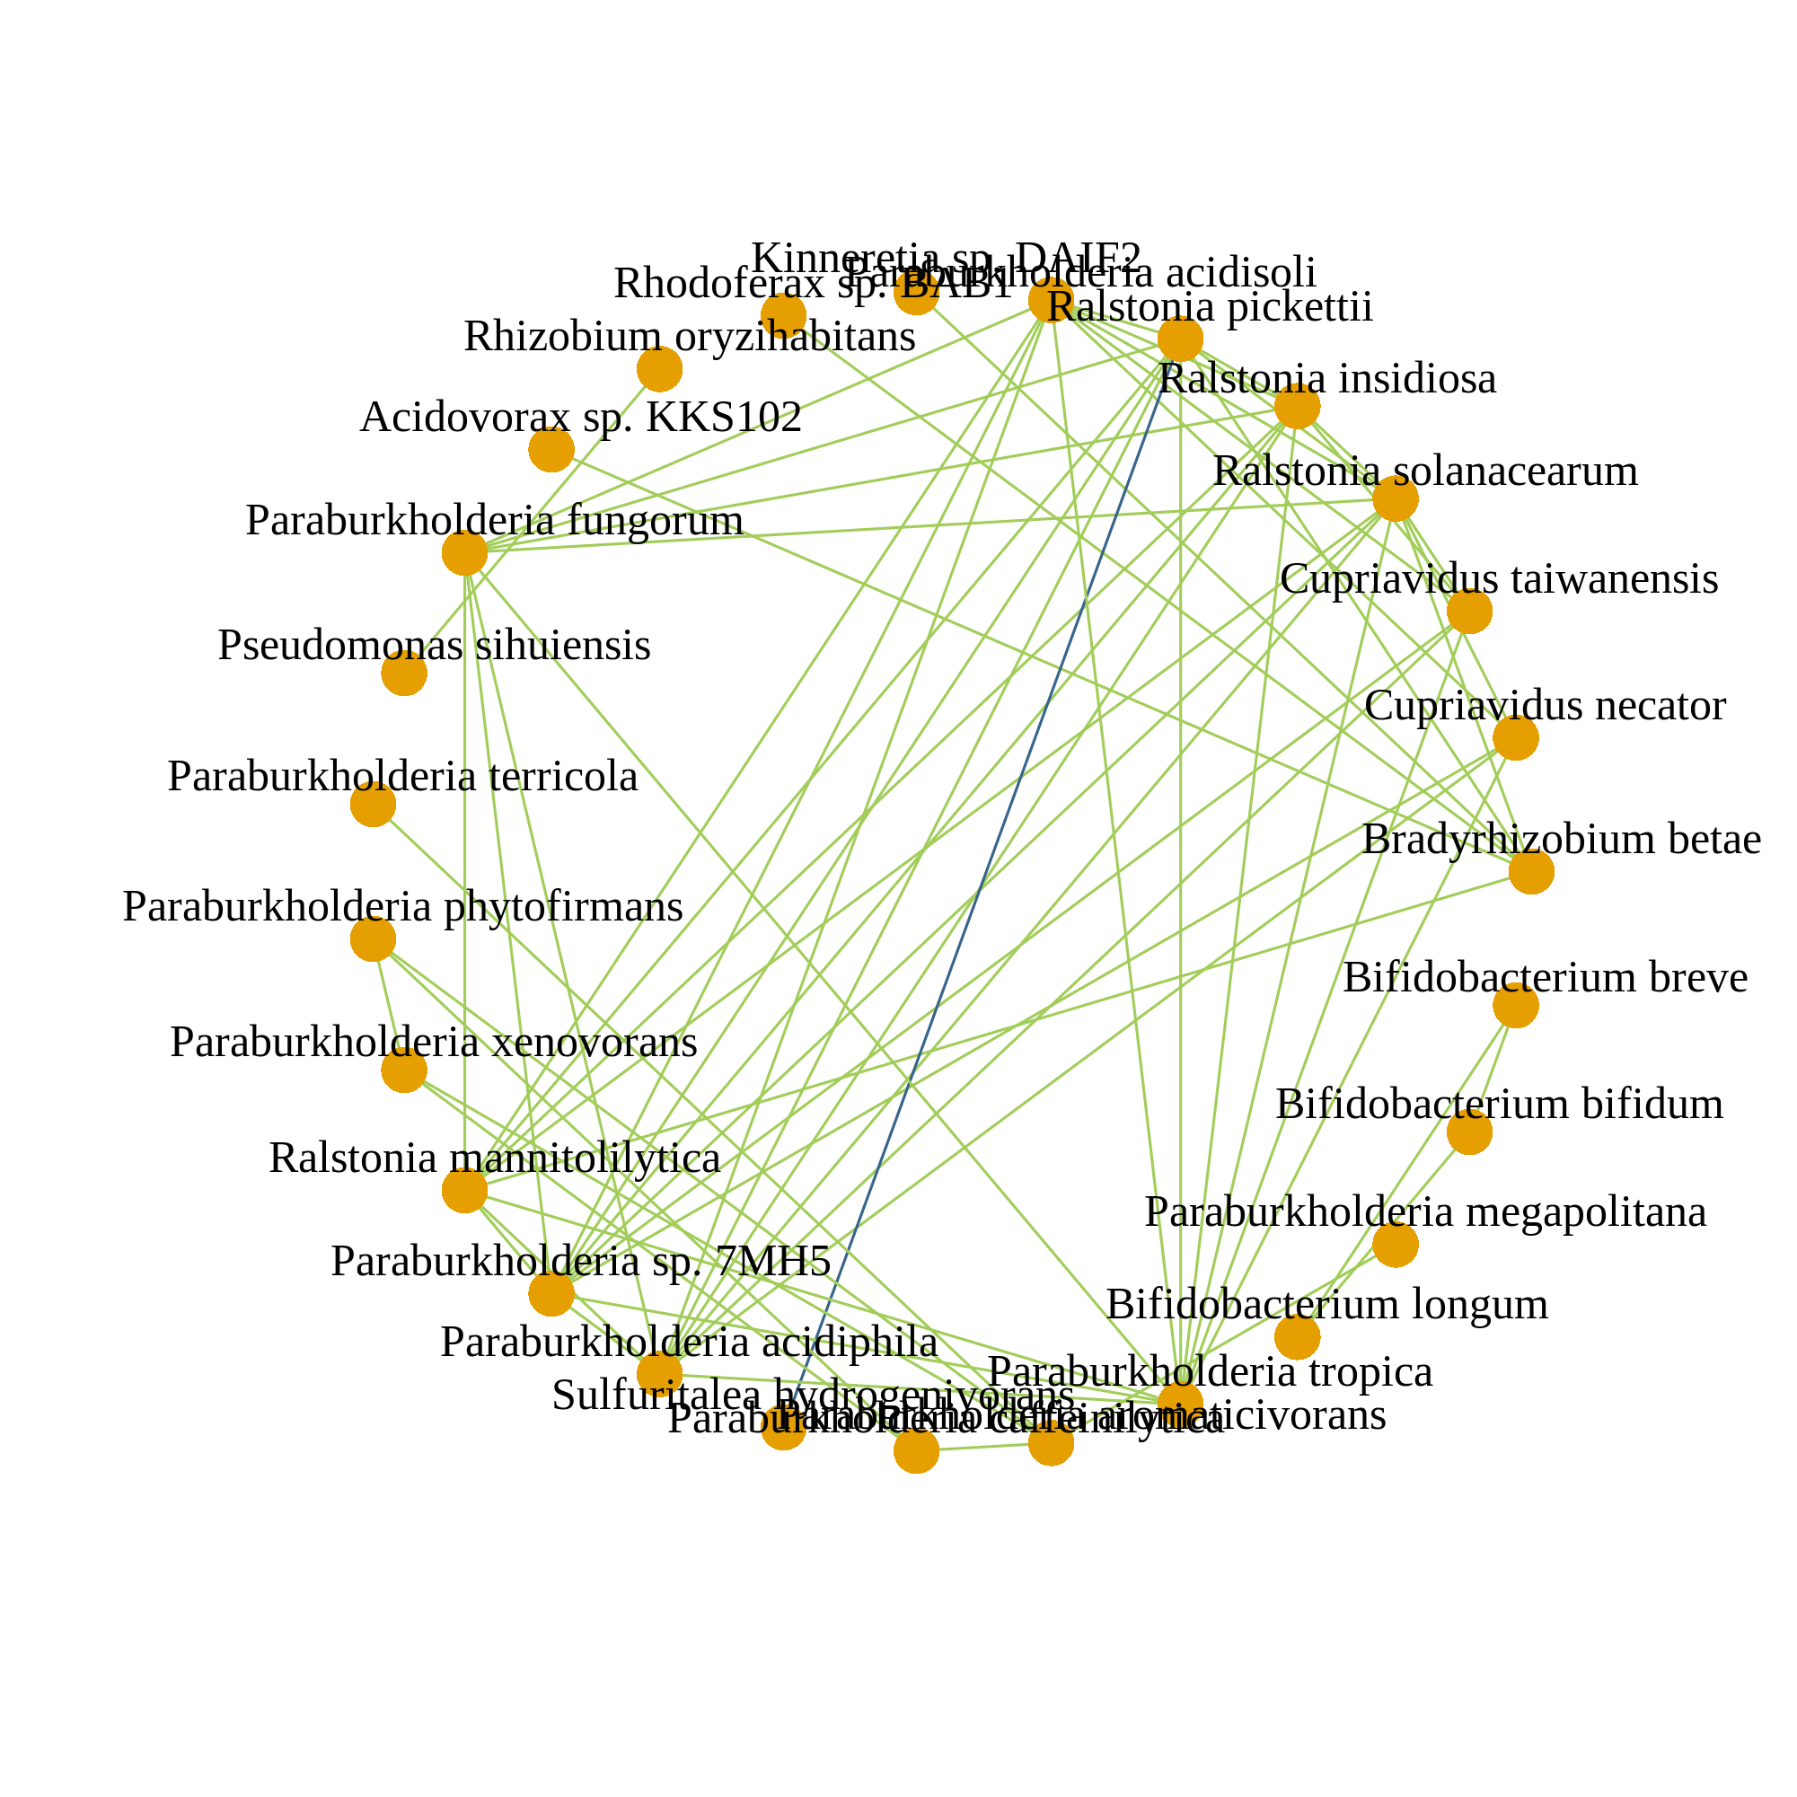
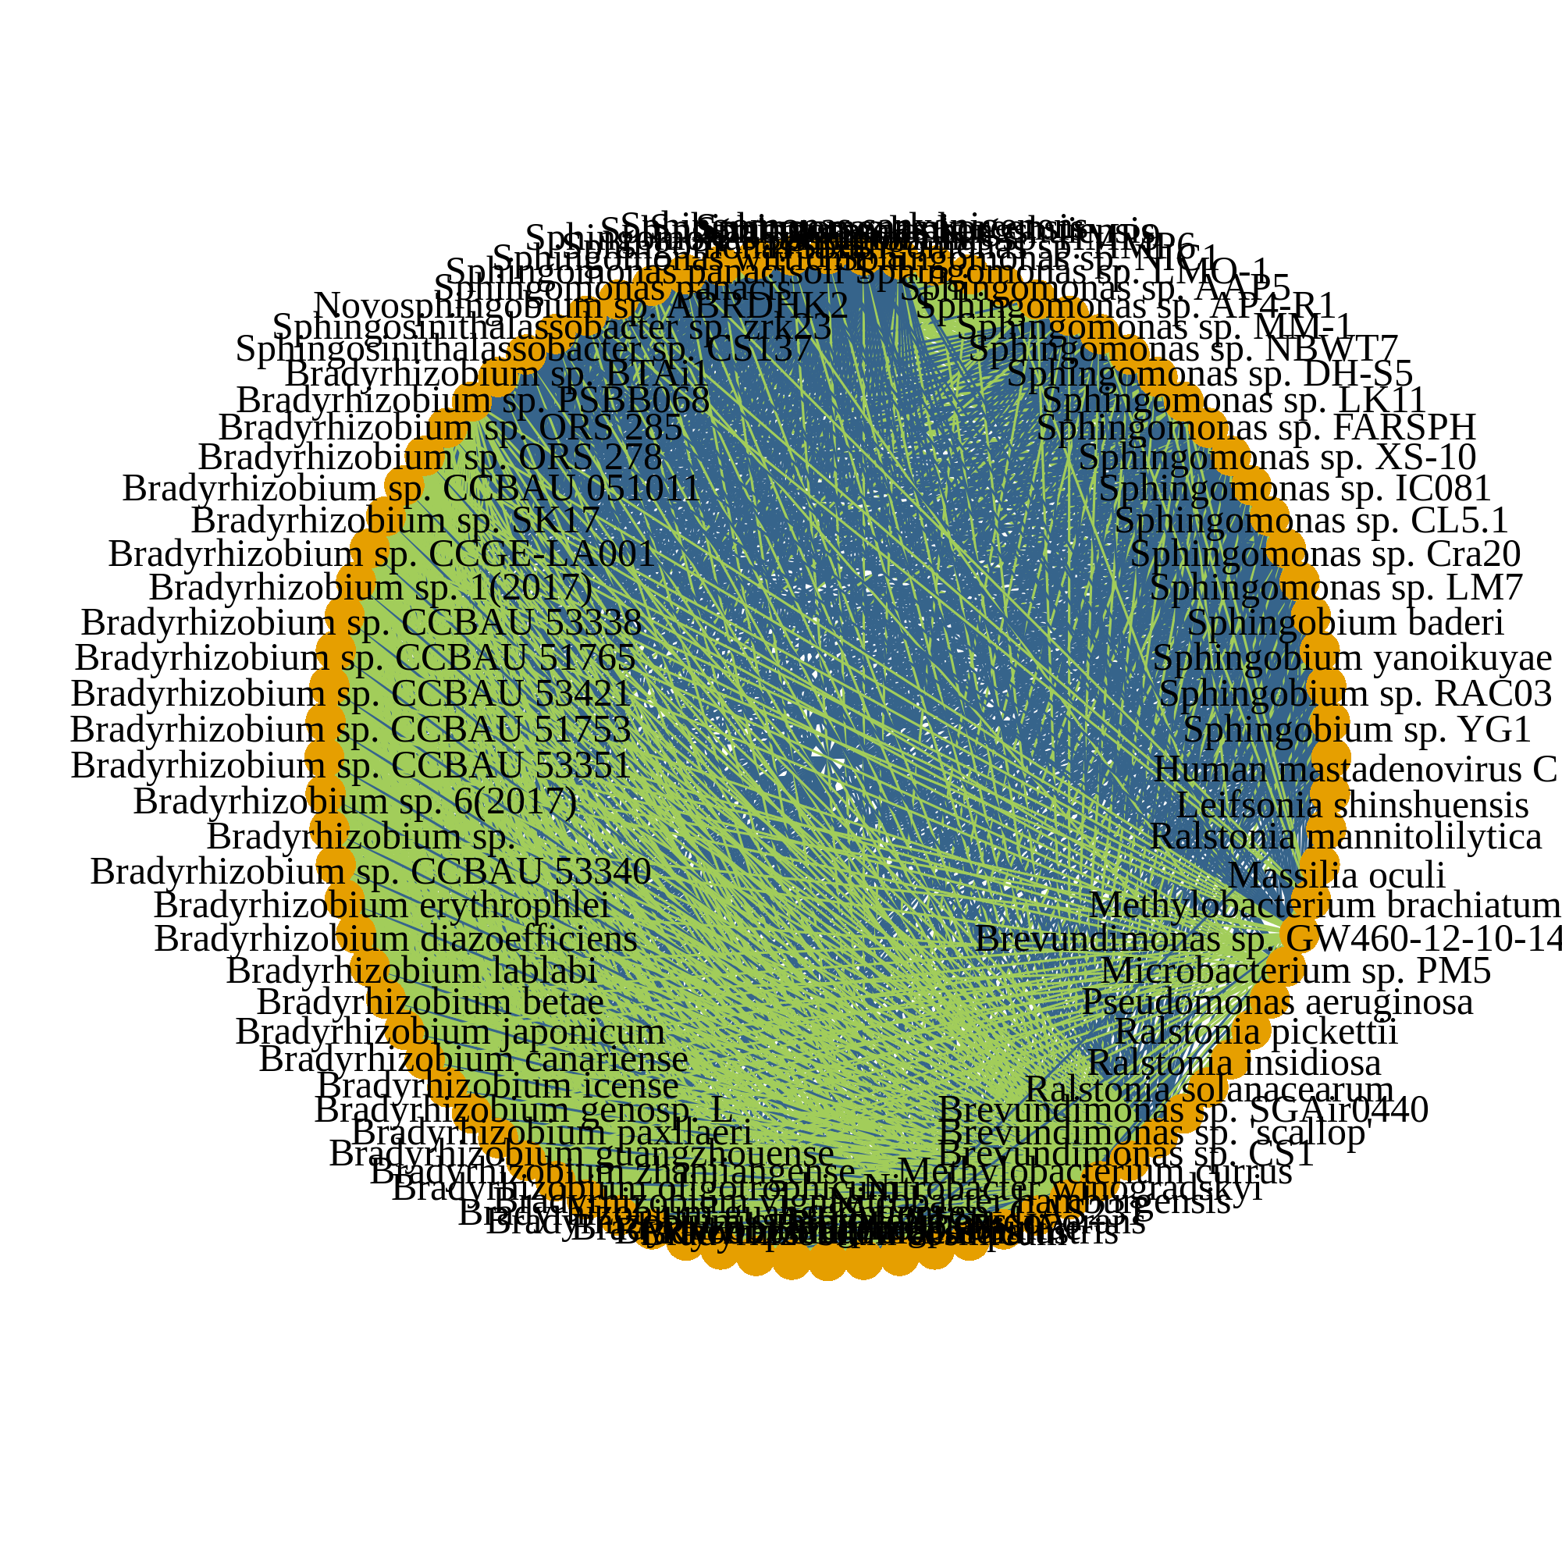
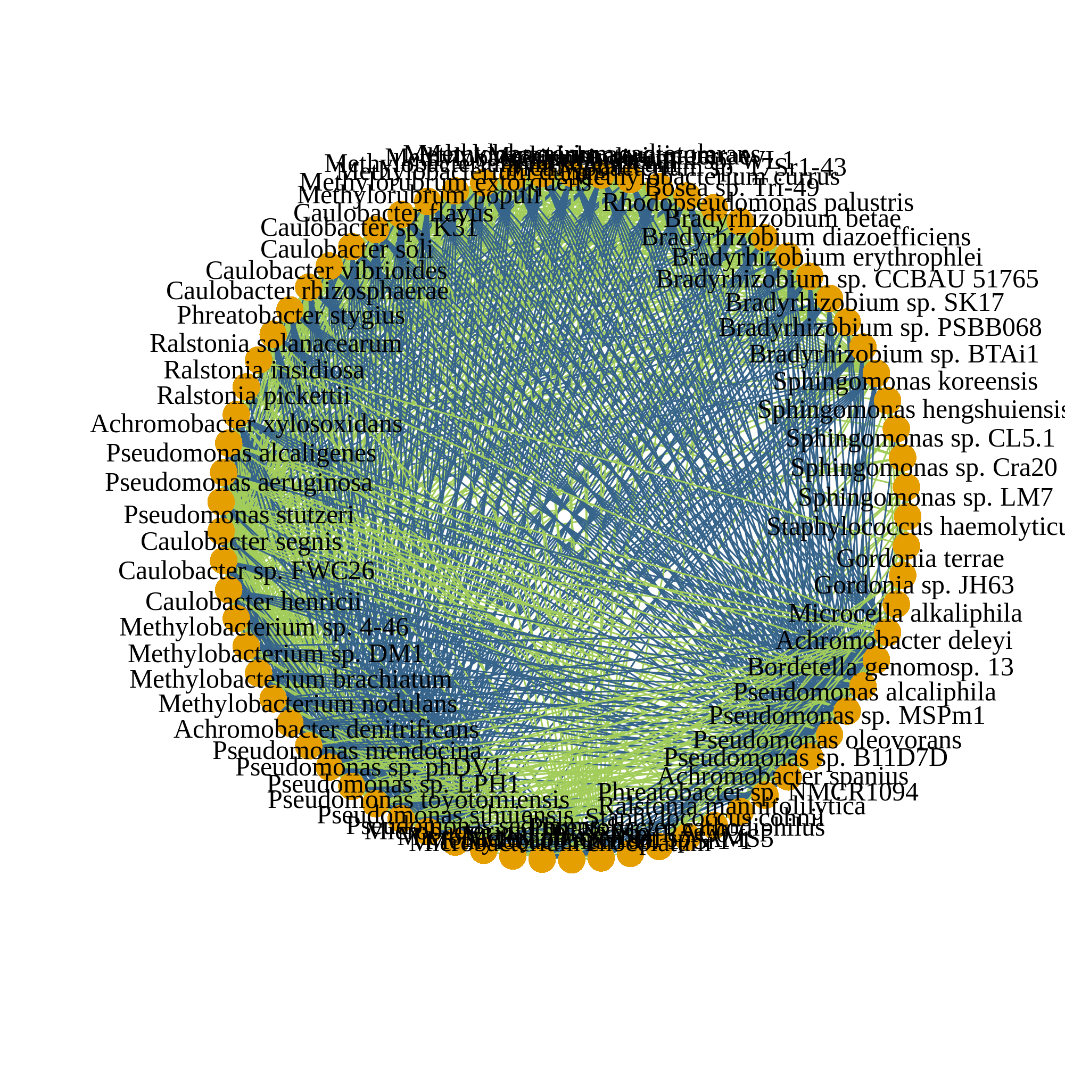
After decontamination (124 species)
a
Corr. > 0.05
Corr. > 0.1
Corr. > 0.2
n = 1612
Before decontamination (871 species)
b
Corr. > 0.2
HELIOS (n = 2284)
TTSH (n = 653)
SERI (n = 835)
MEC (n = 2713)
PRISM (n = 1248)
No common associations
Legend
Microbial species
Co-occurrence
Co-exclusion
Notes:
Figure 4

Slide 5
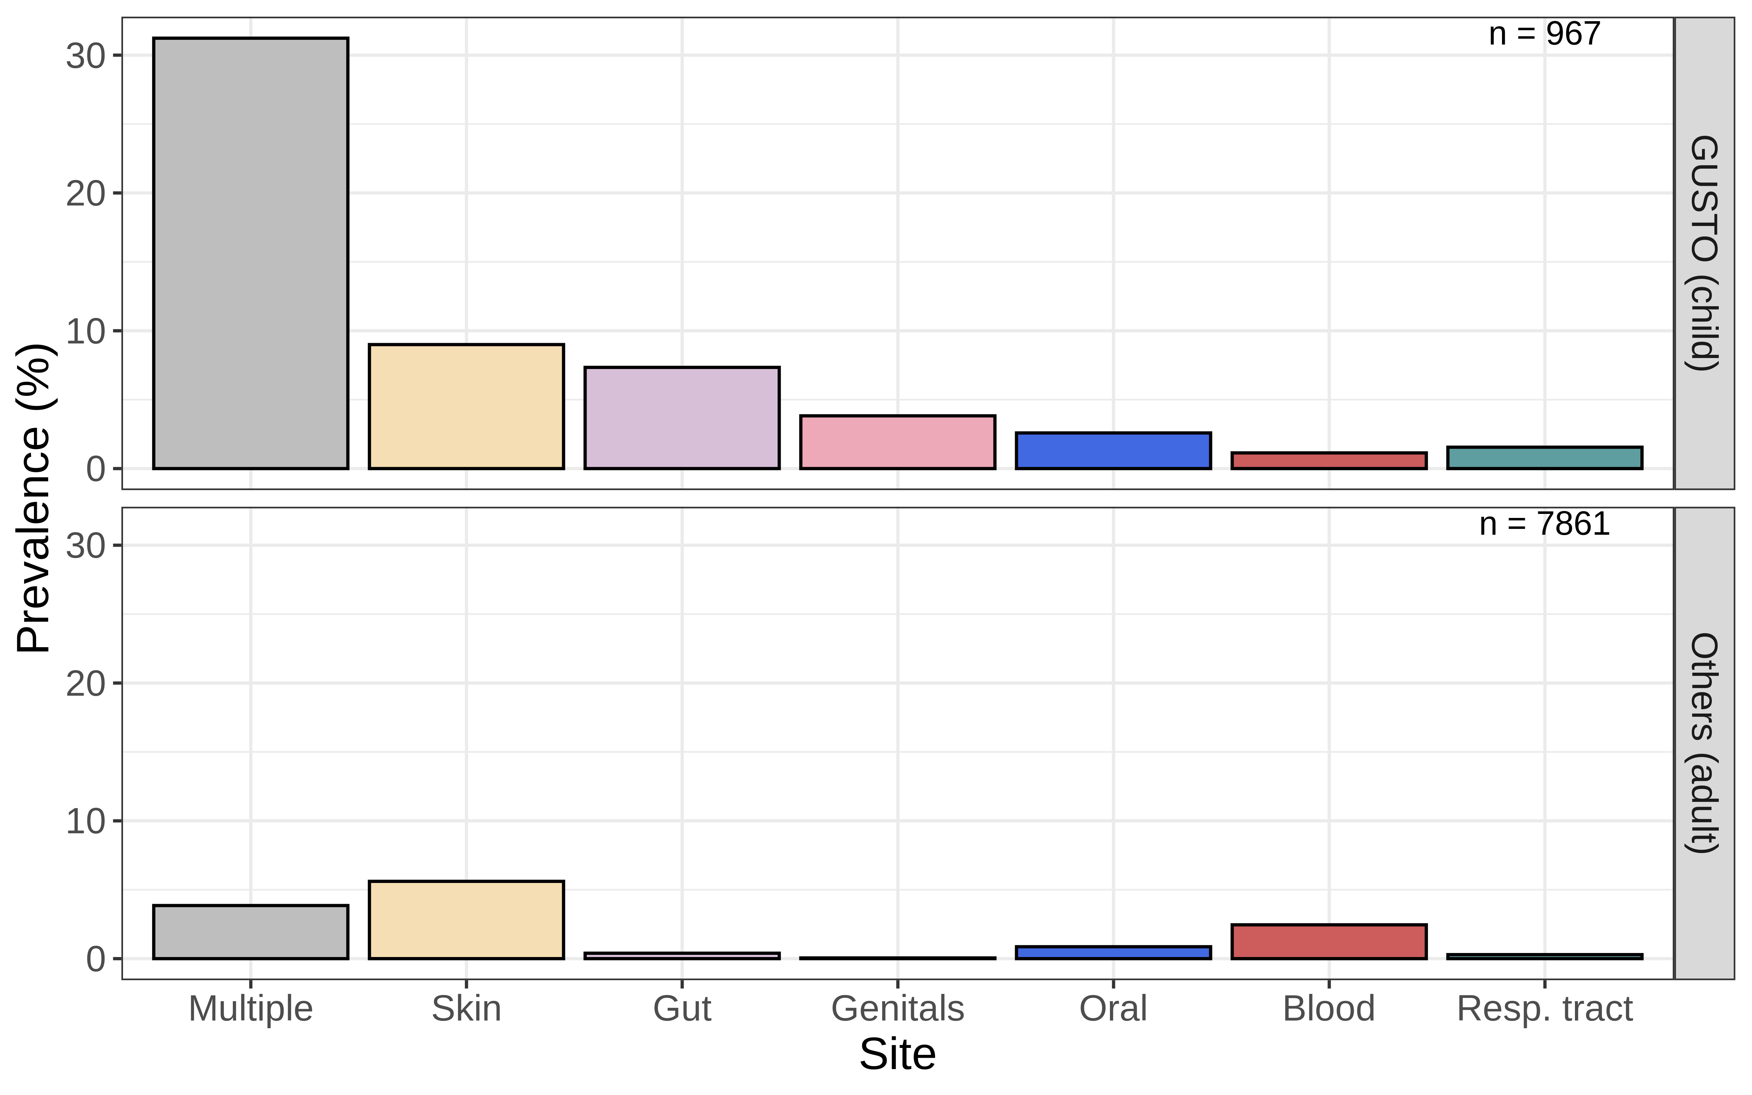


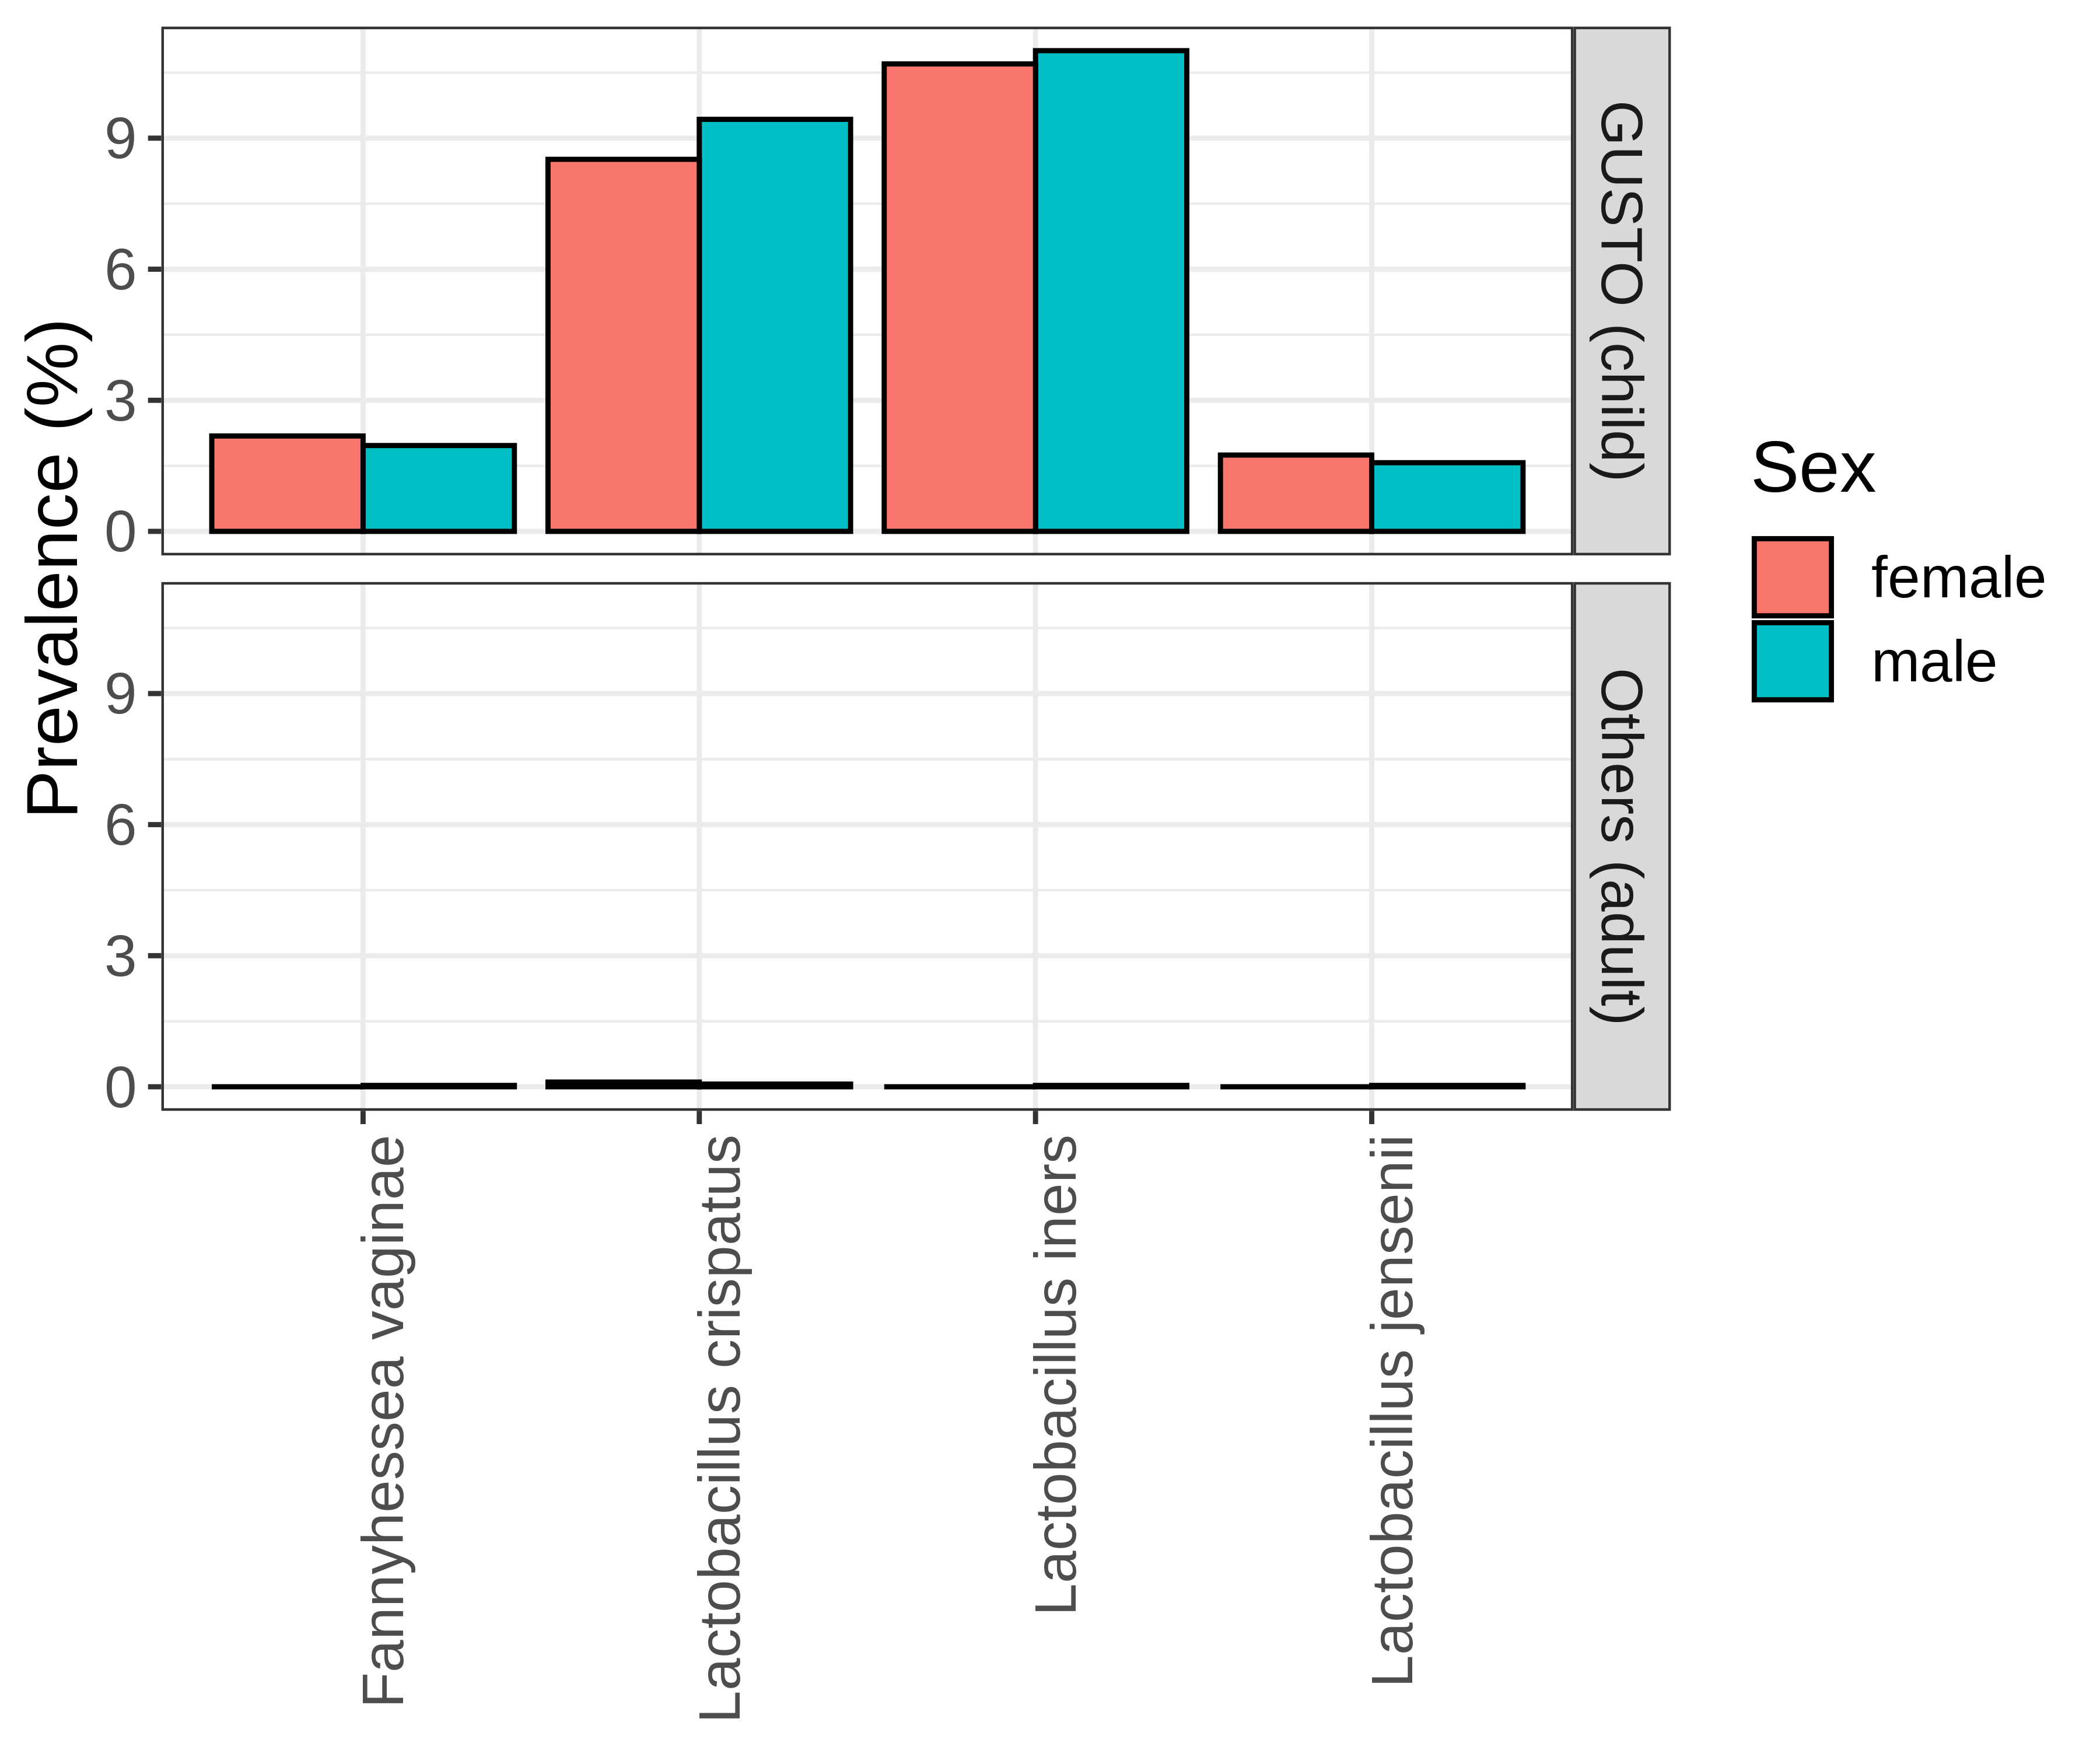
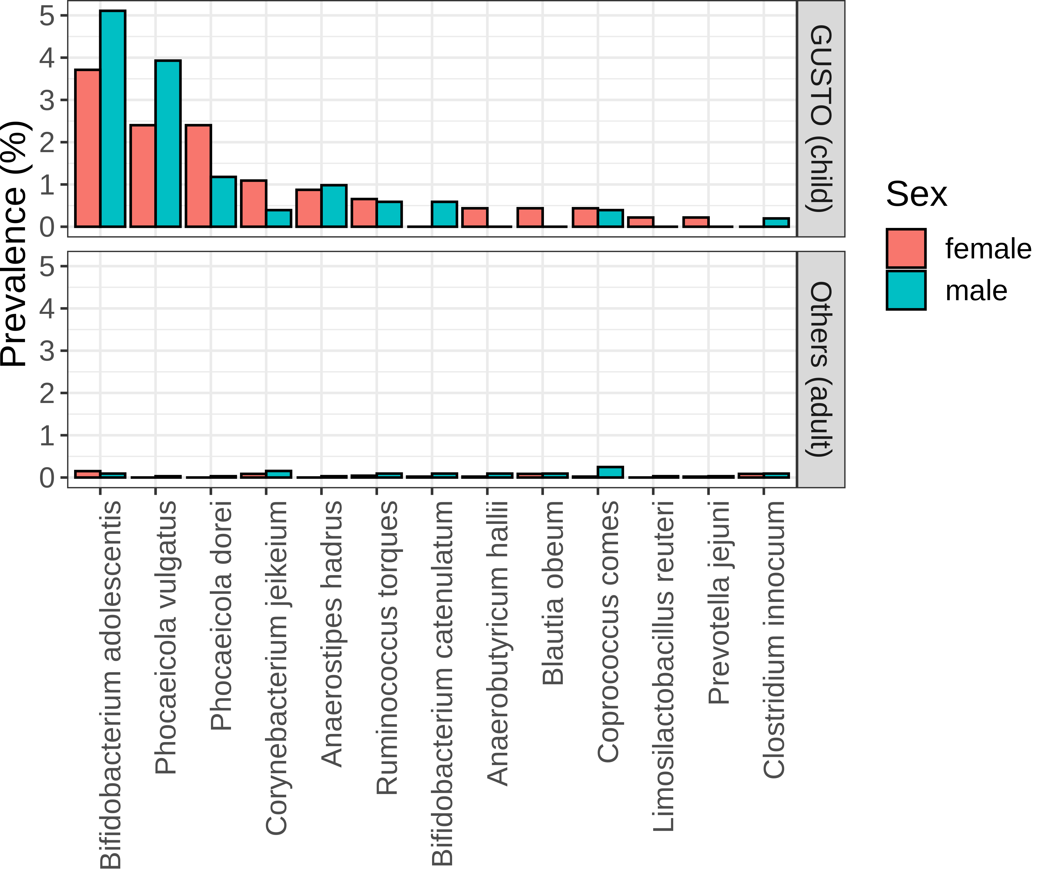
a
b
c
Genital microbes
Gut microbes
Notes:
Figure 4
Check paraburkholderia
Check bias of each column with cohorts
Substratify species

Slide 6
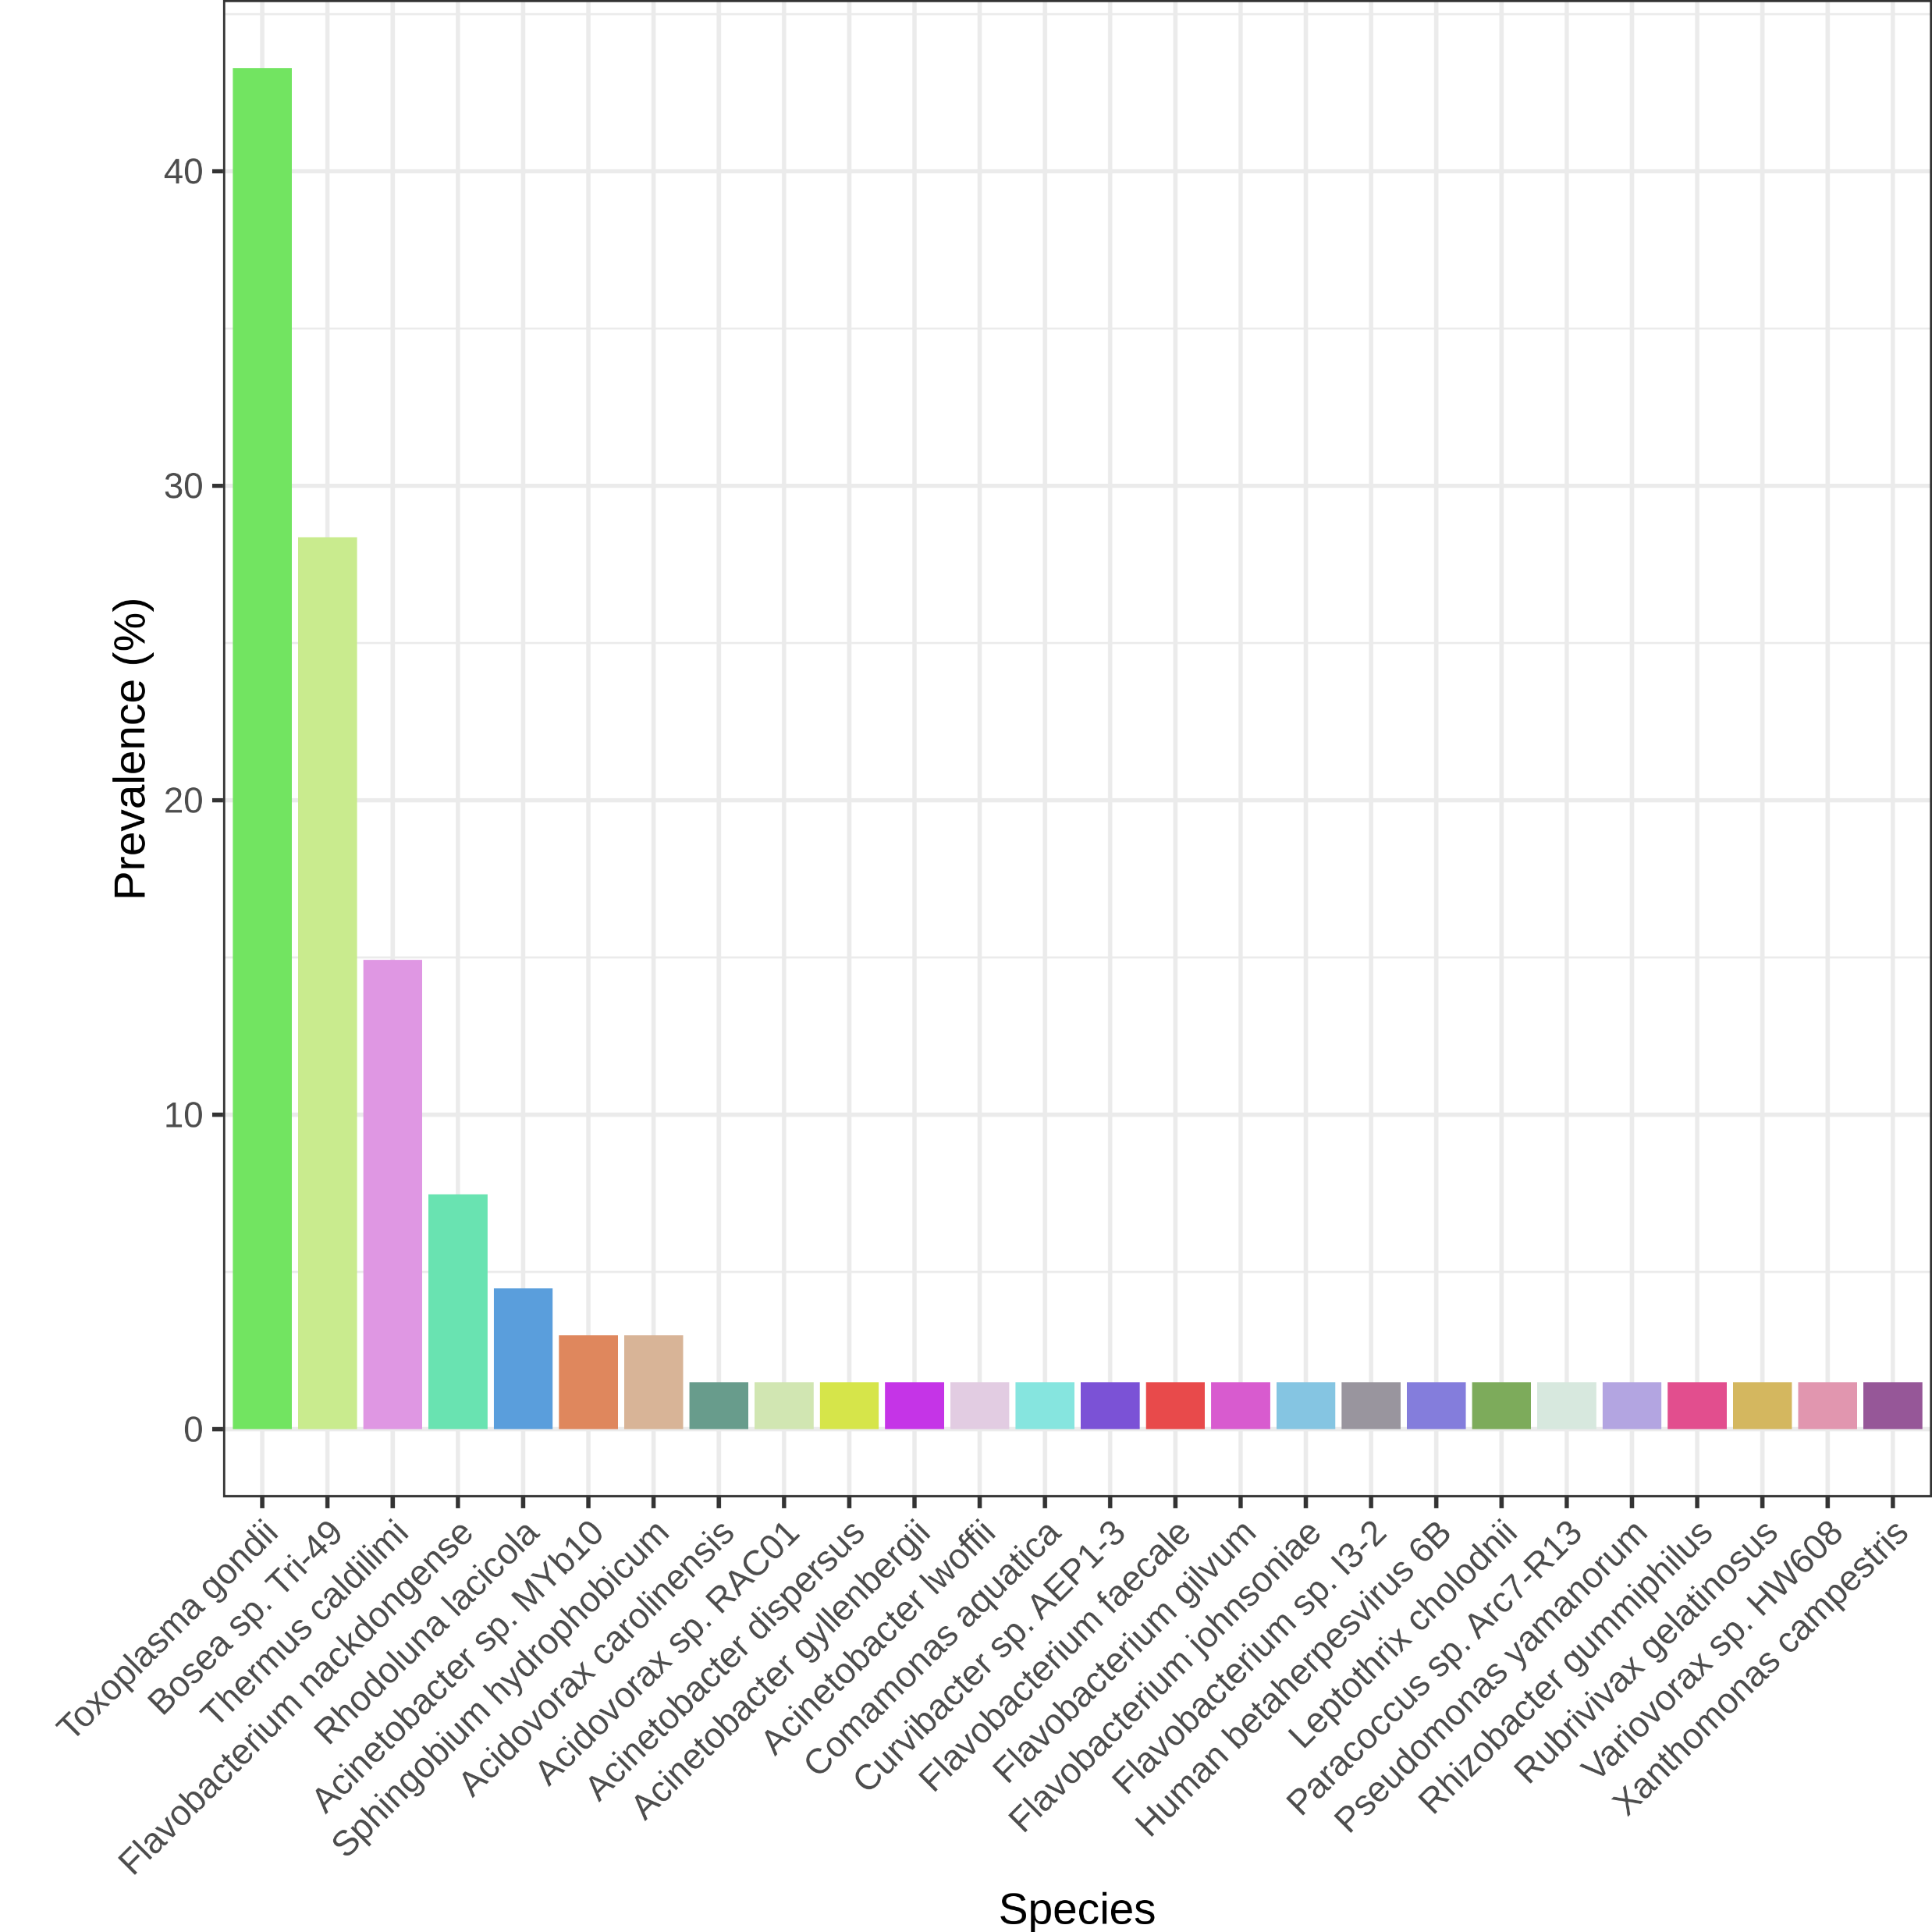
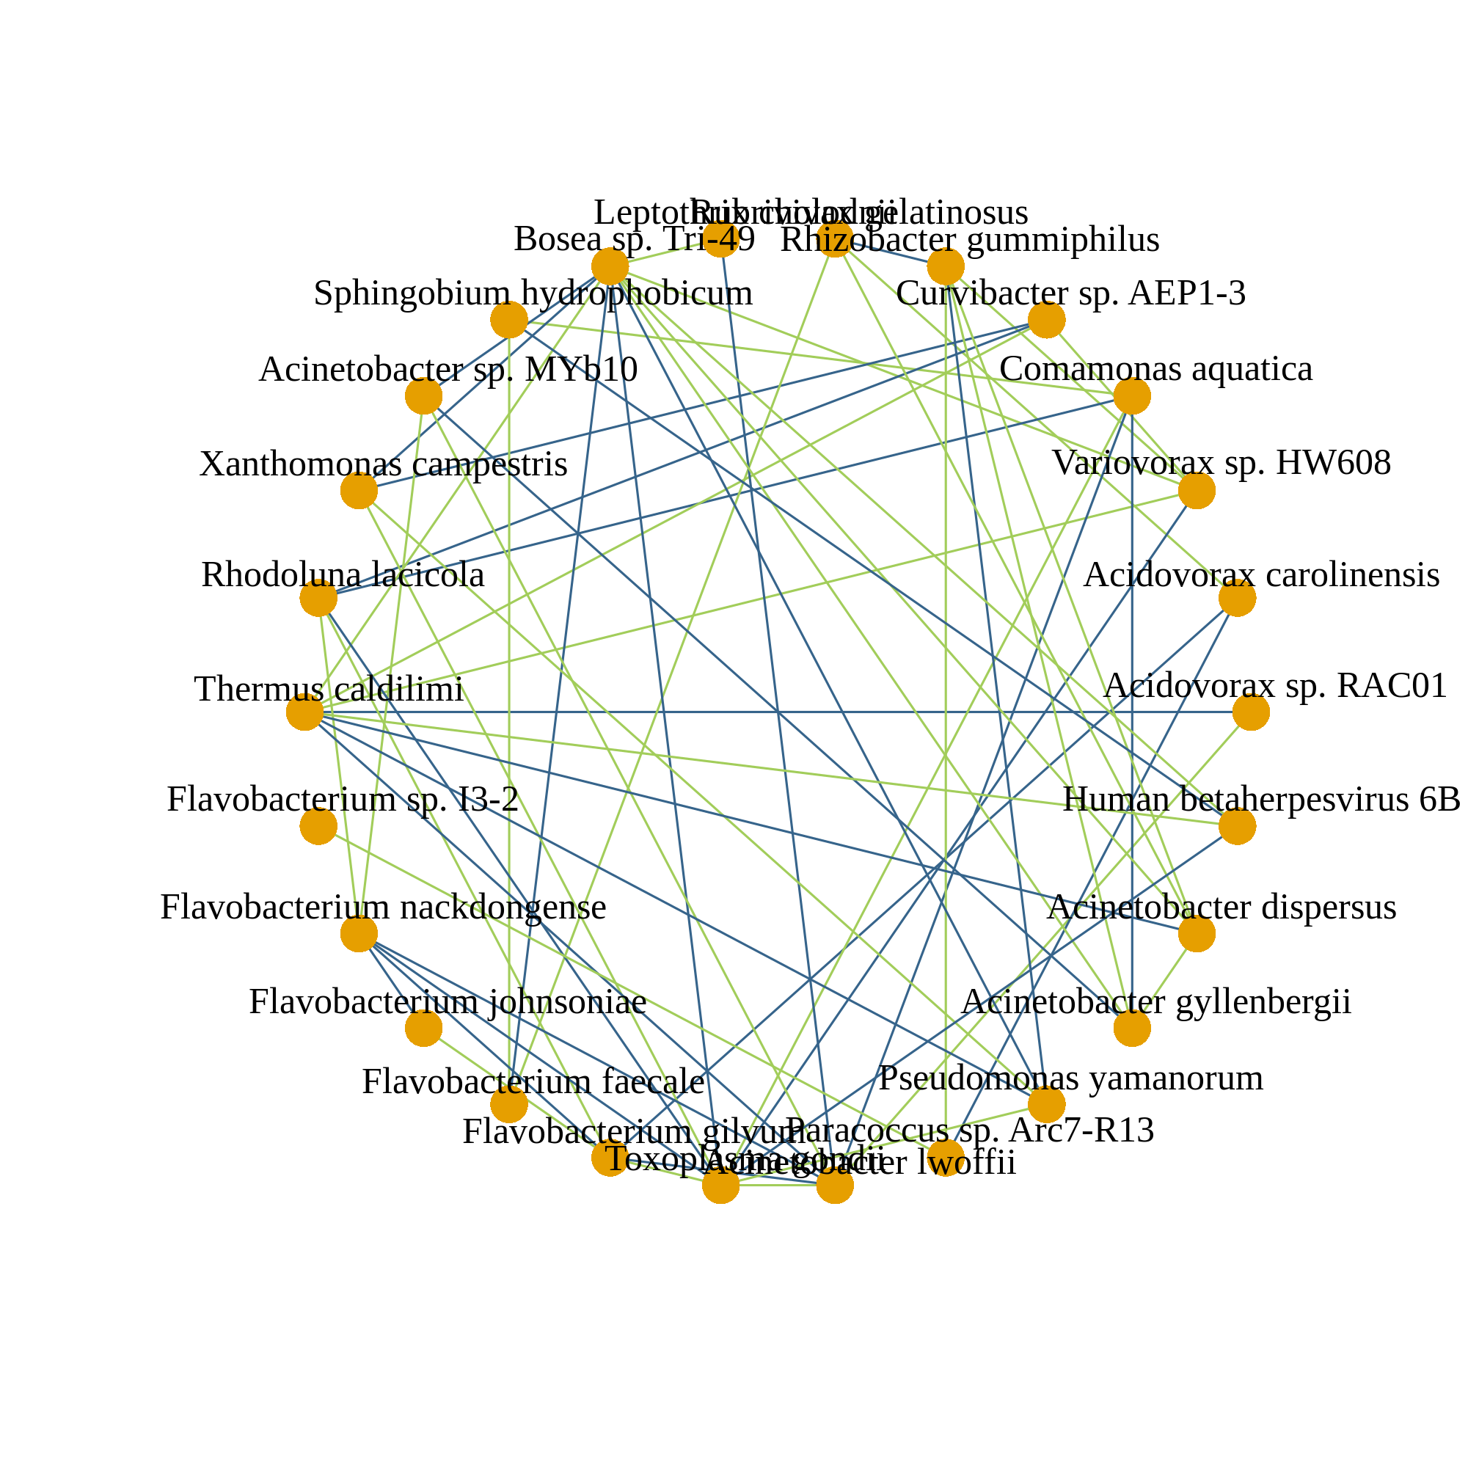
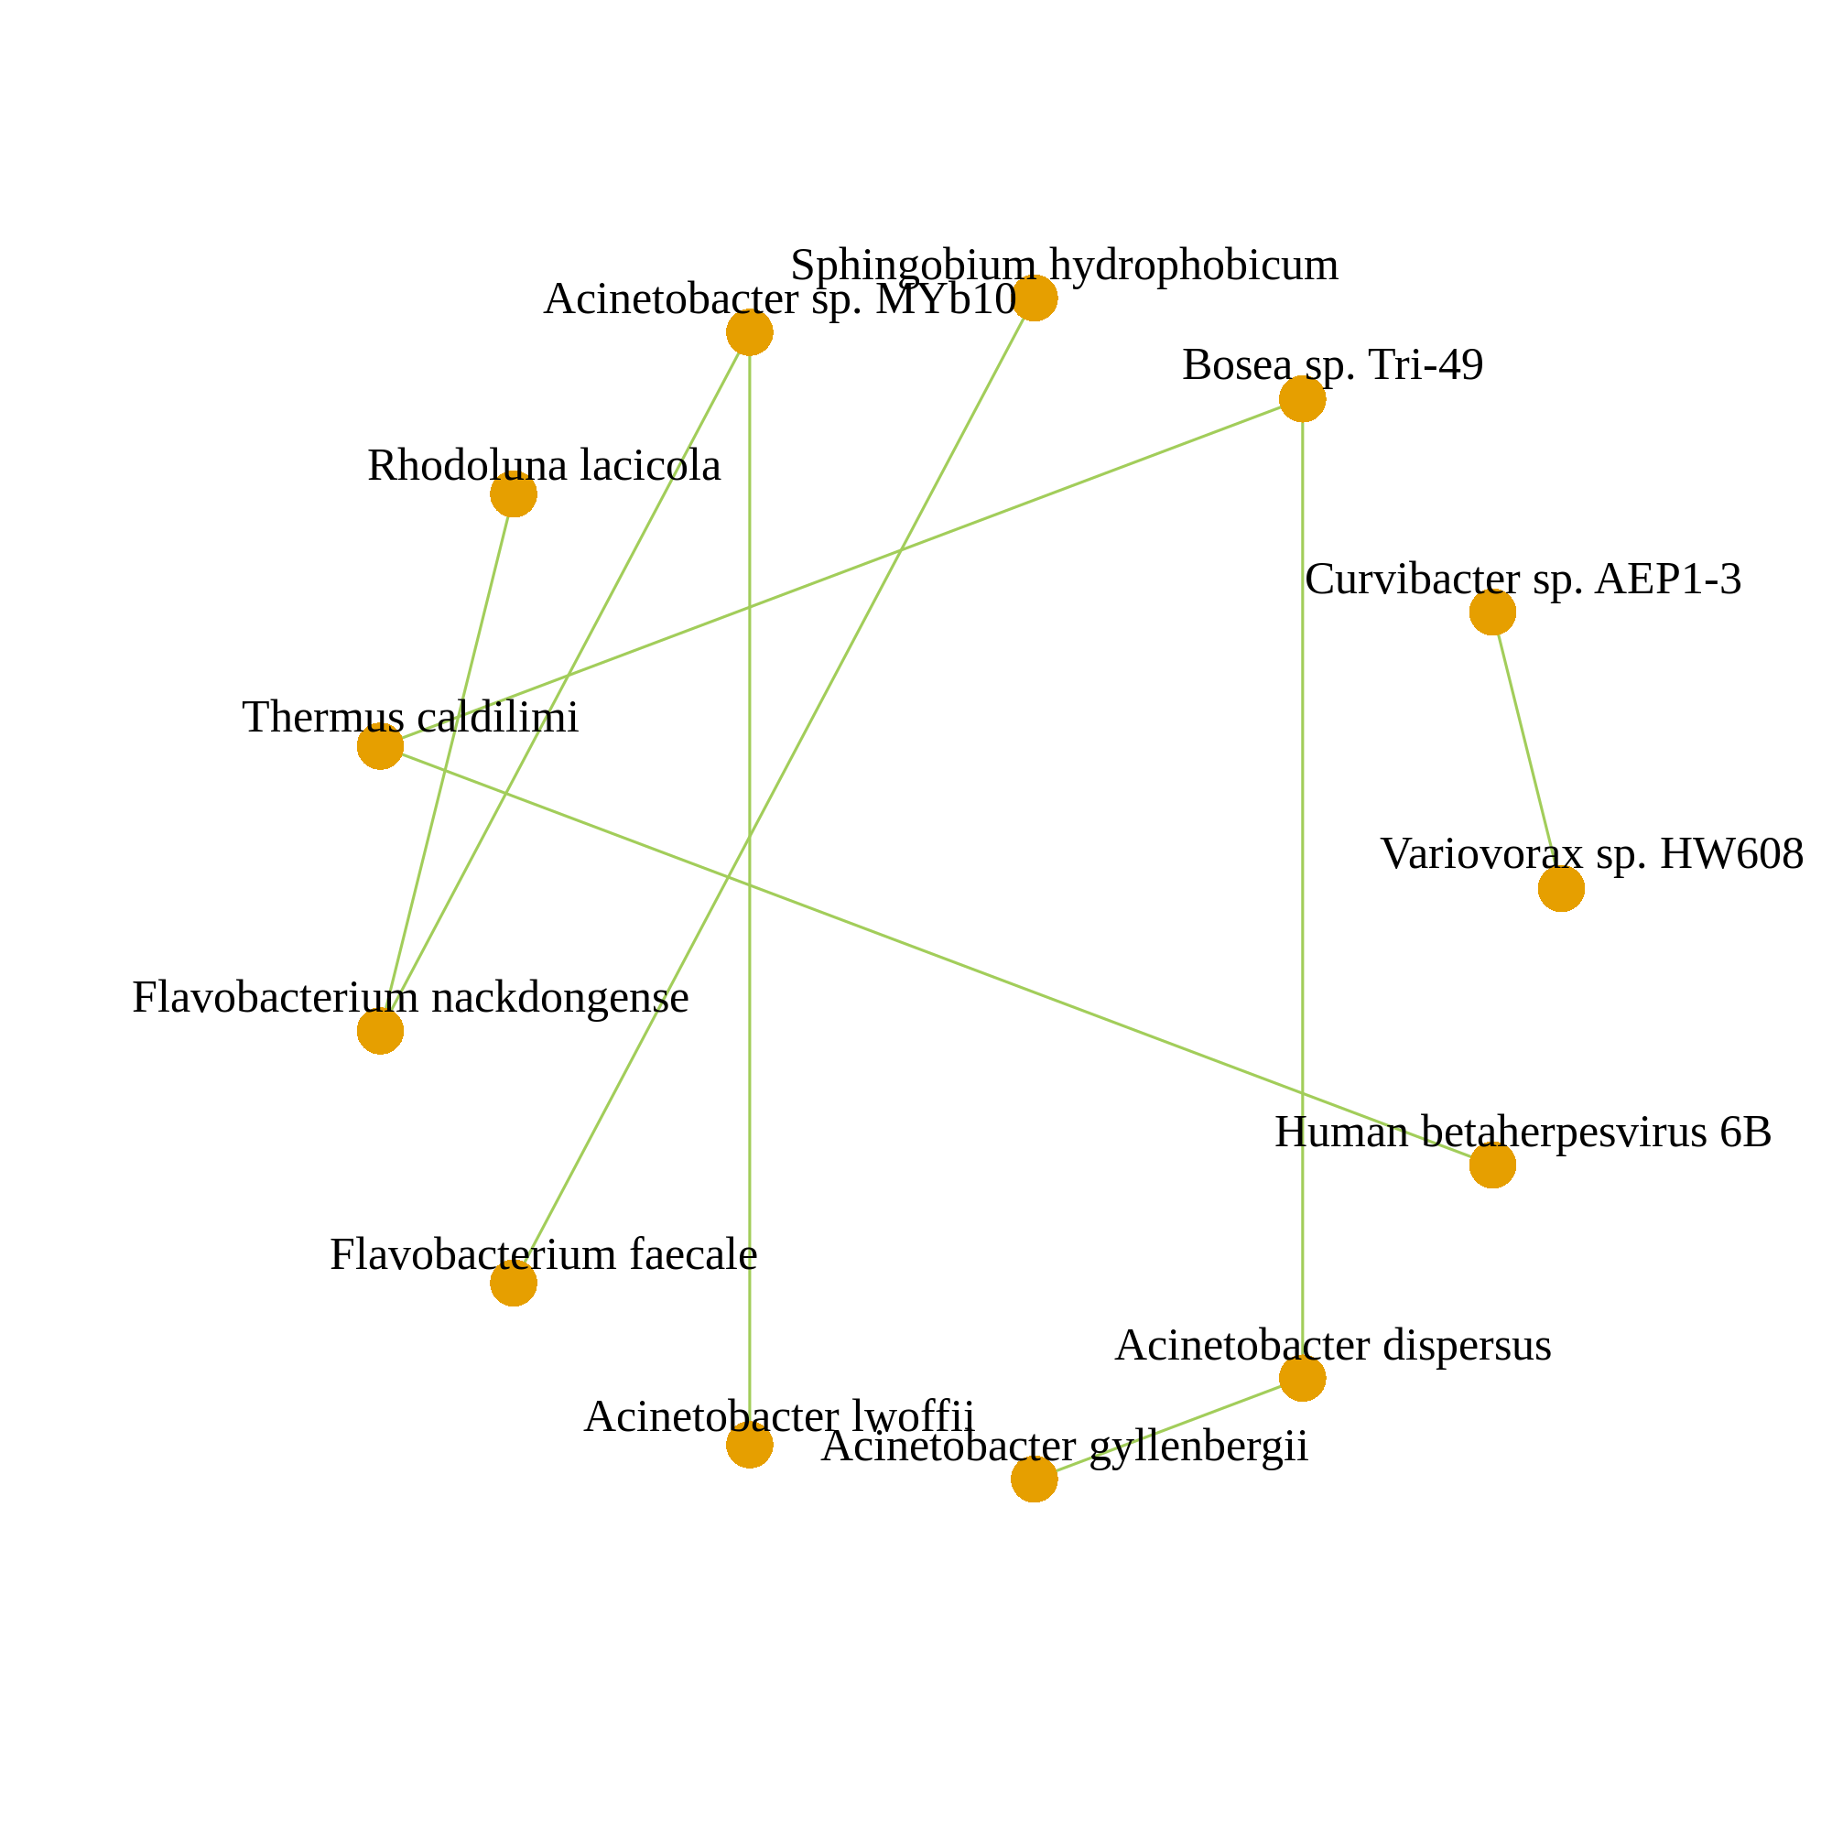

a
Corr. > 0.05
Corr. > 0.1
b
Corr. > 0.2
n = 67
Legend
Microbial species
Co-occurrence
Co-exclusion
Notes:
Figure 5

Slide 7
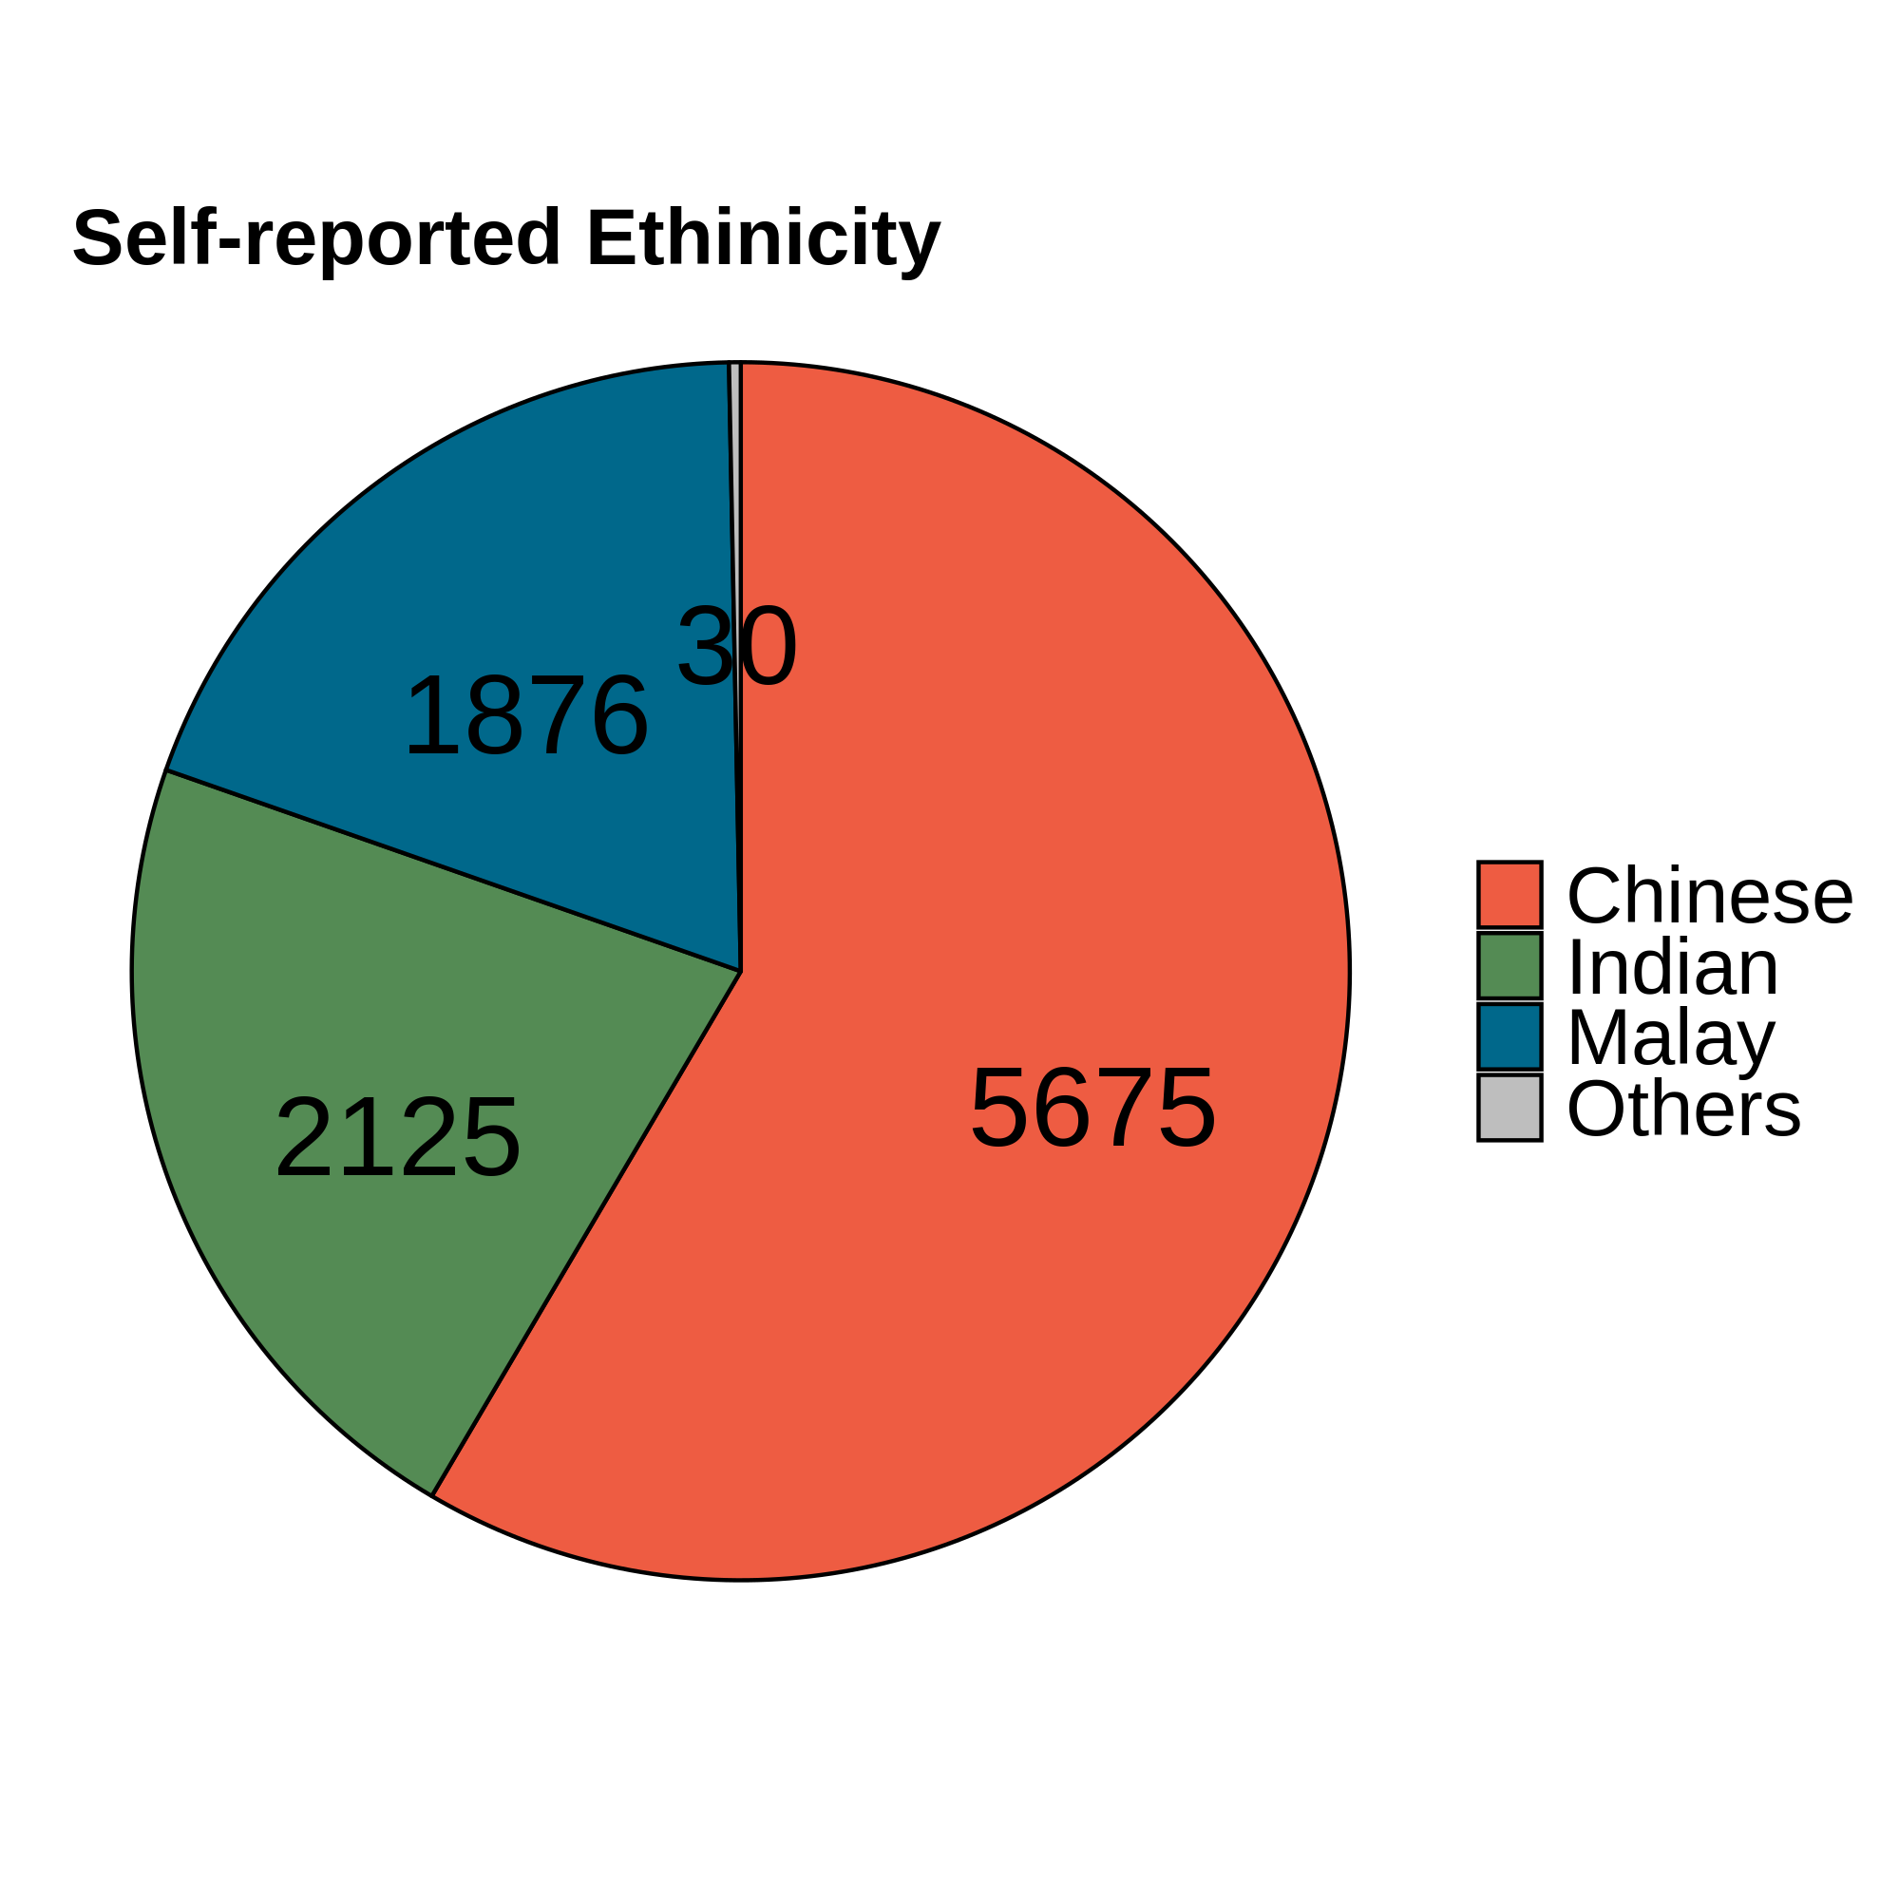
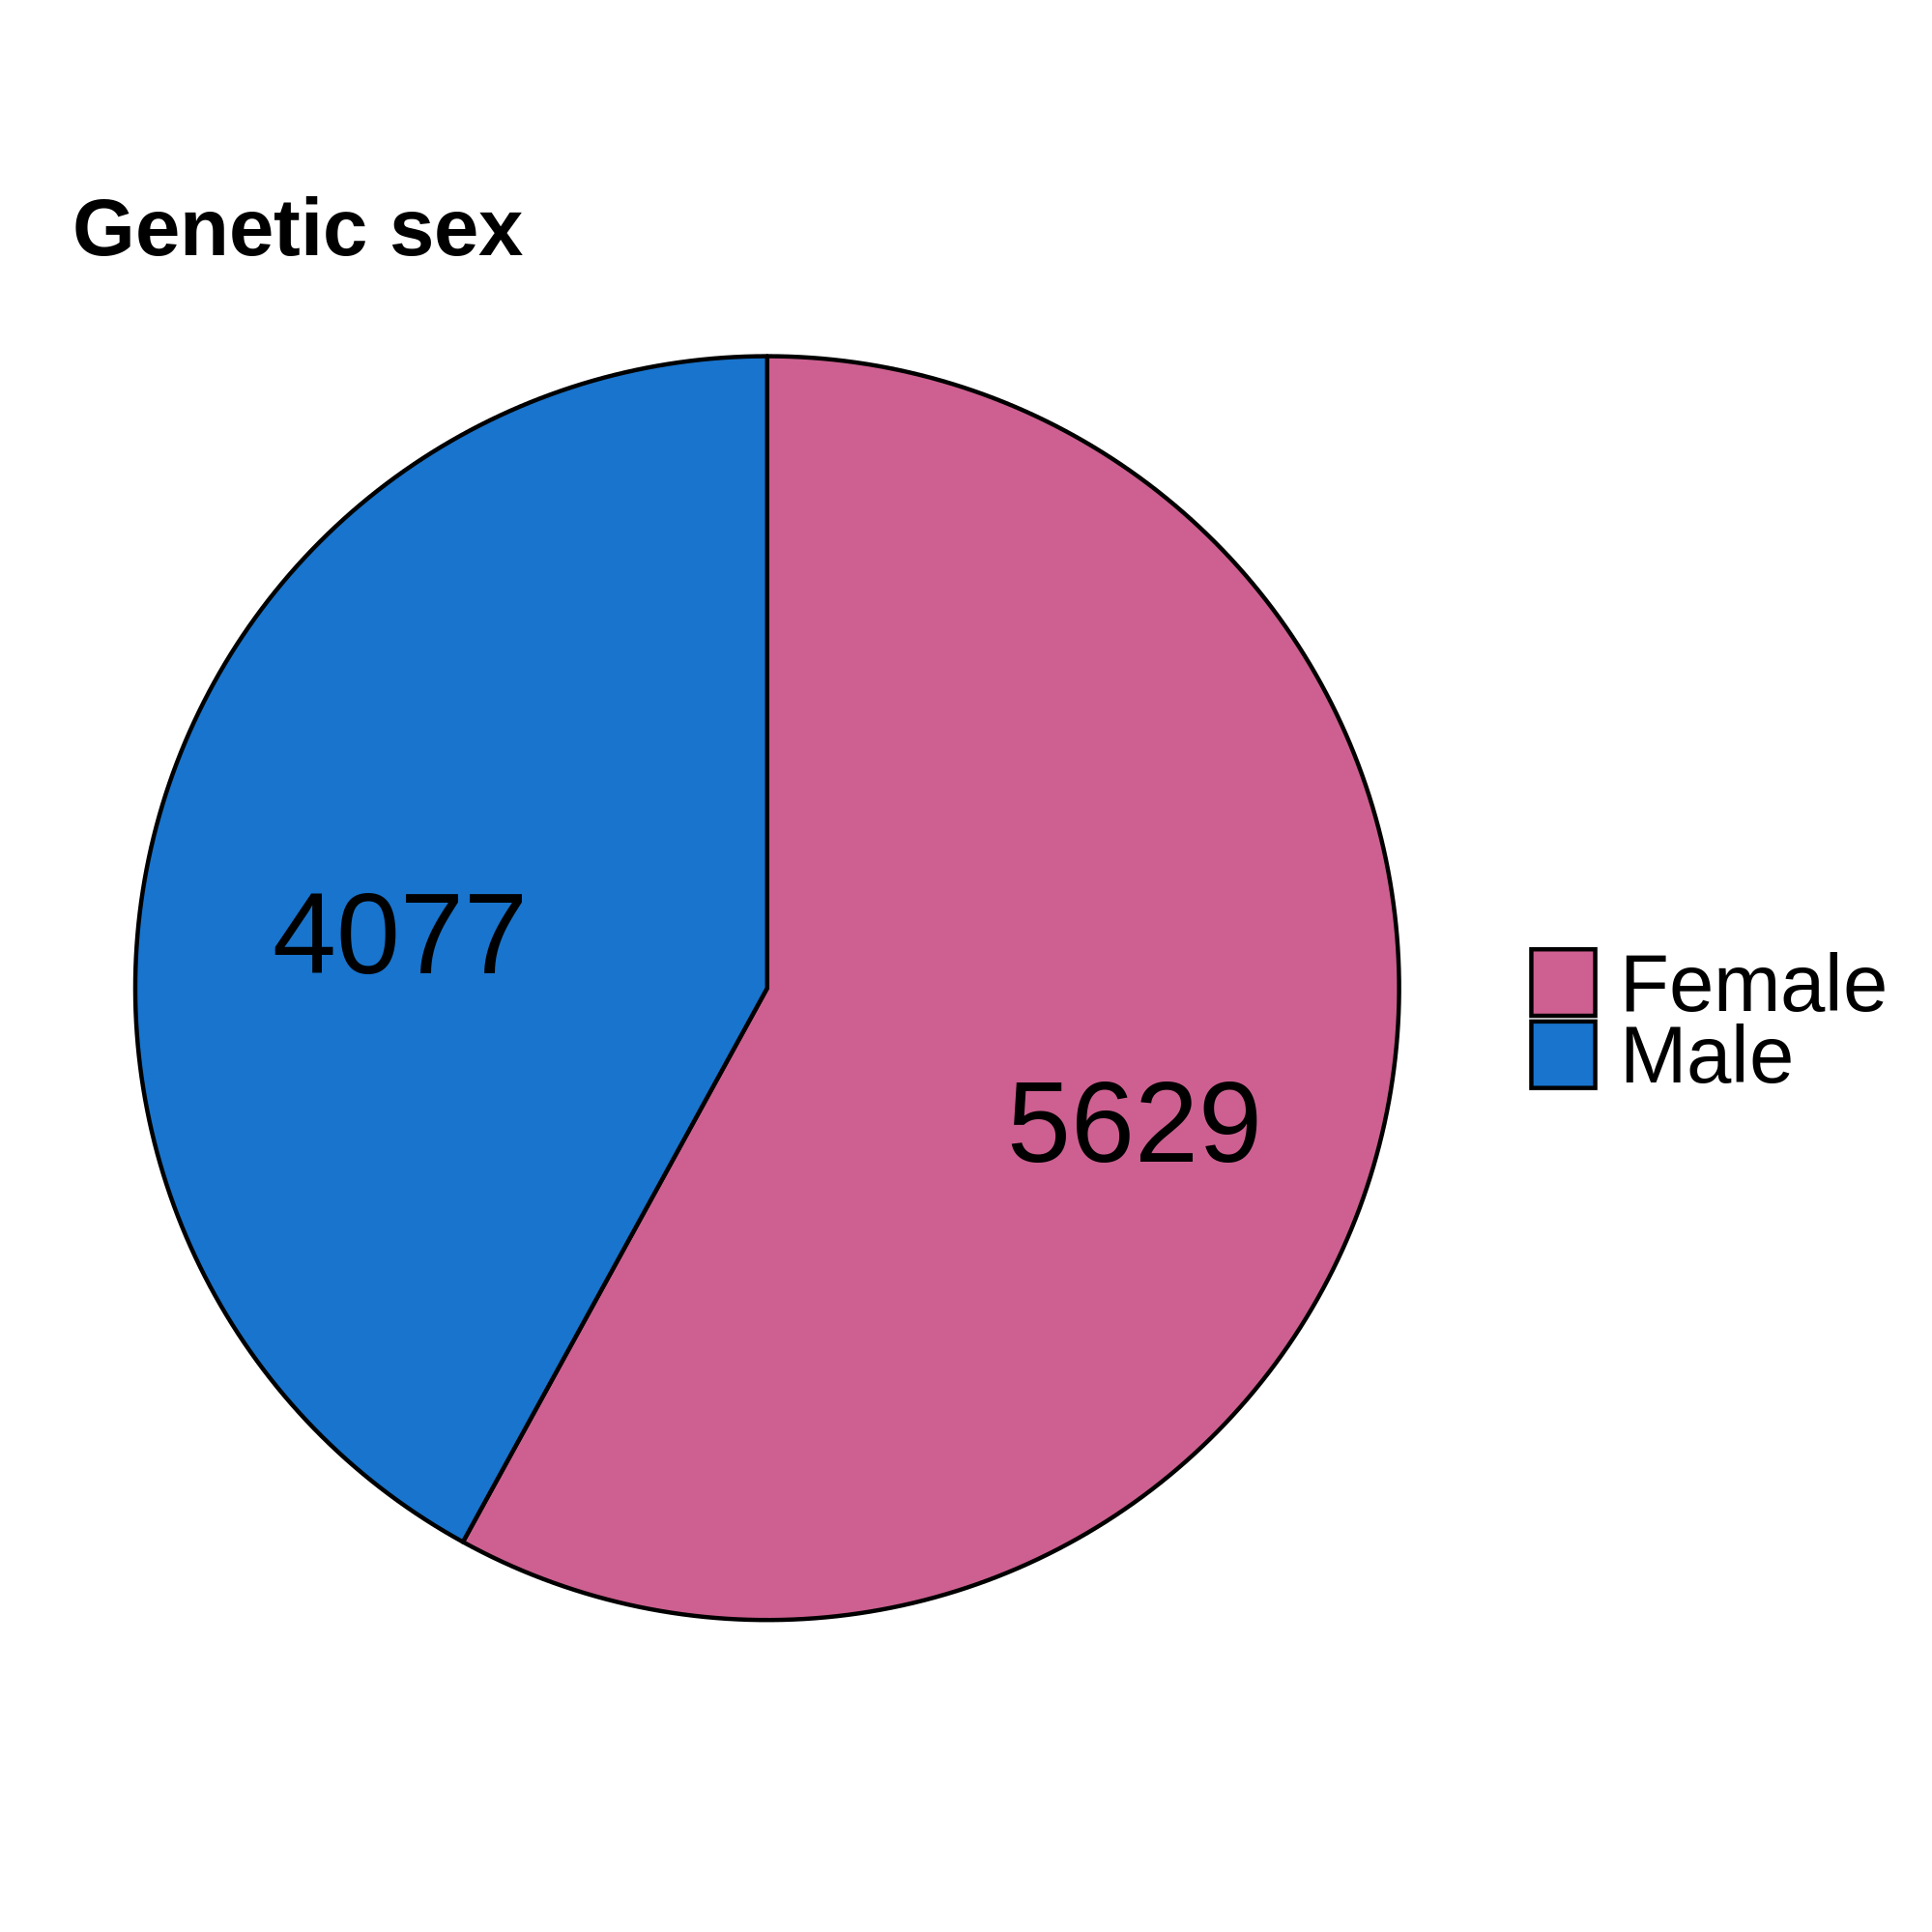
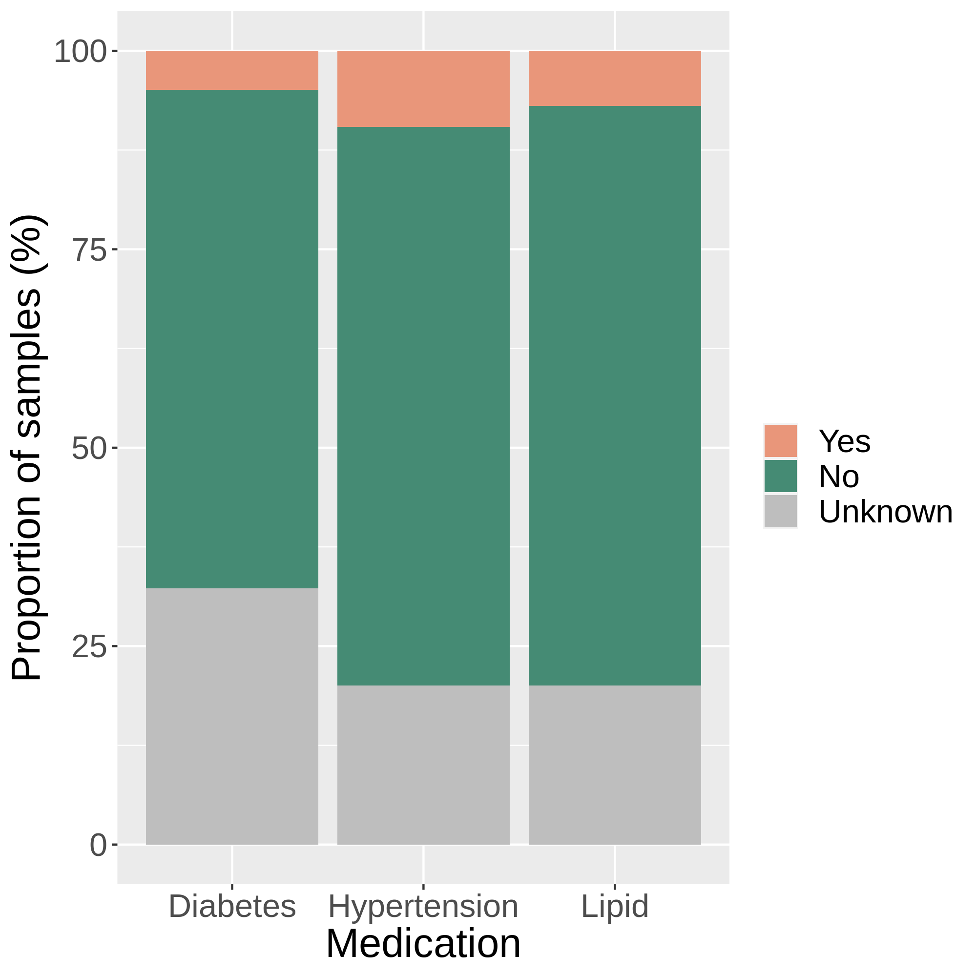
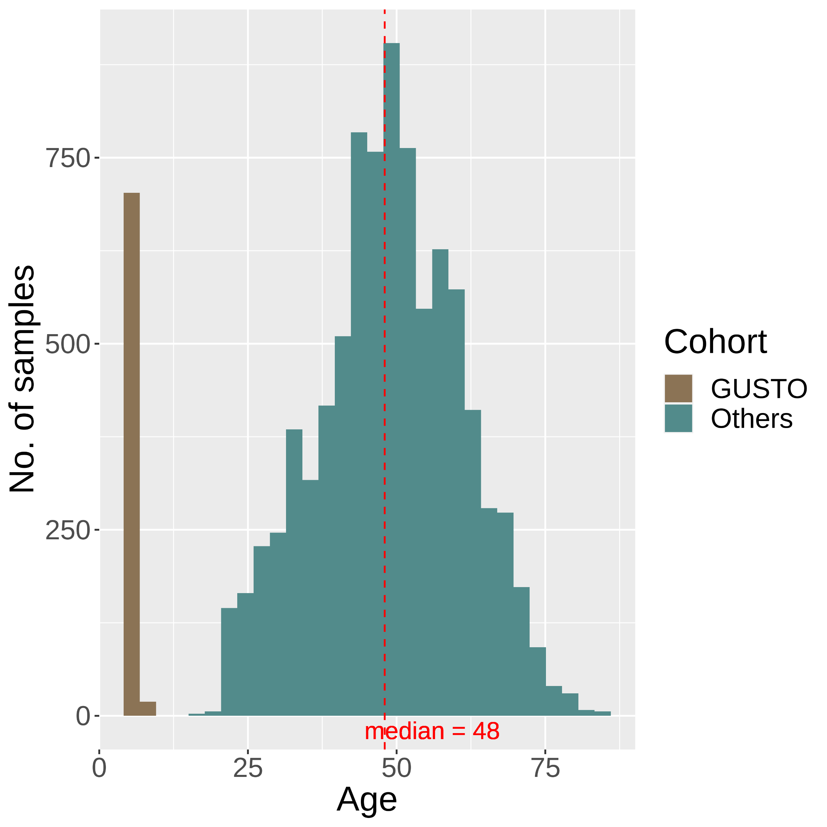
(a)
(b)
(c)
(d)
Notes:
Figure S1

Slide 8
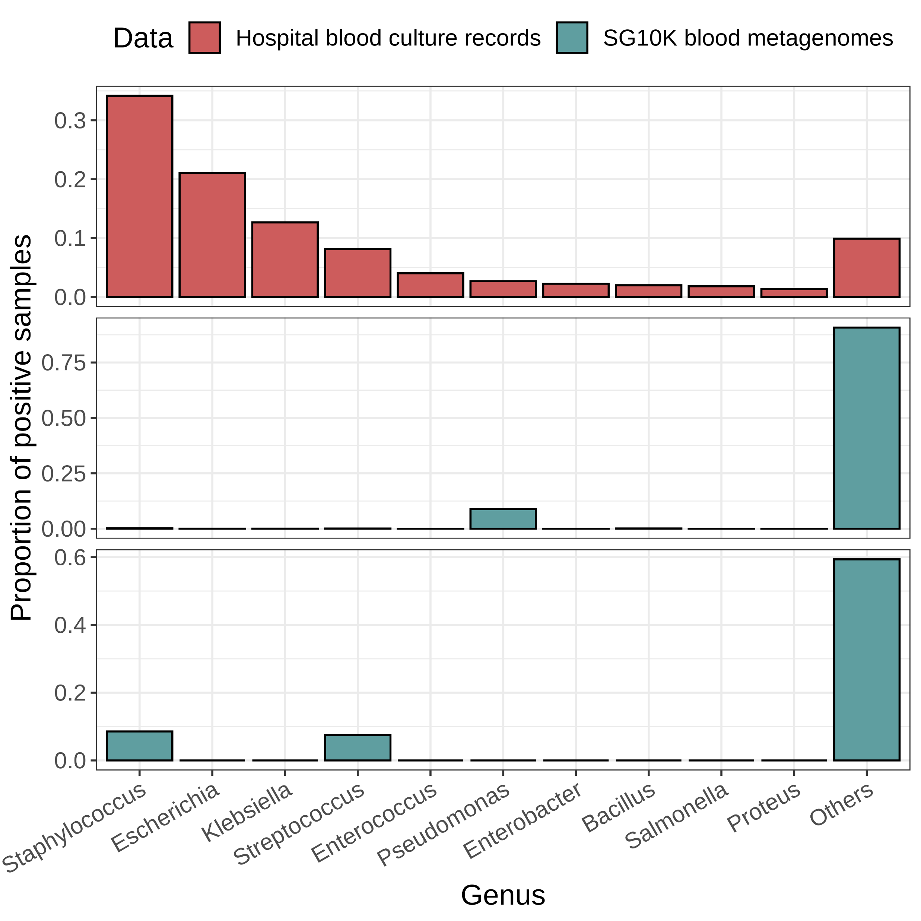
a
Prop. of positive cultures
b
Prop. of microbes detected
(before decontamination)
c
Prop. of non-contaminant species

Slide 9
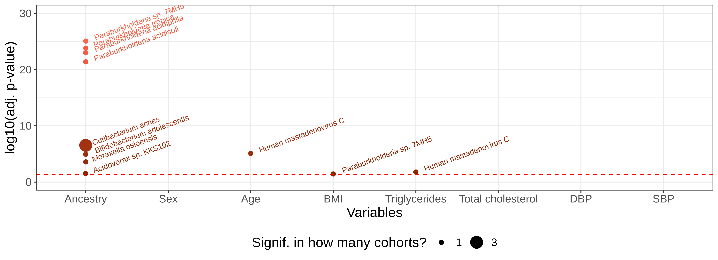
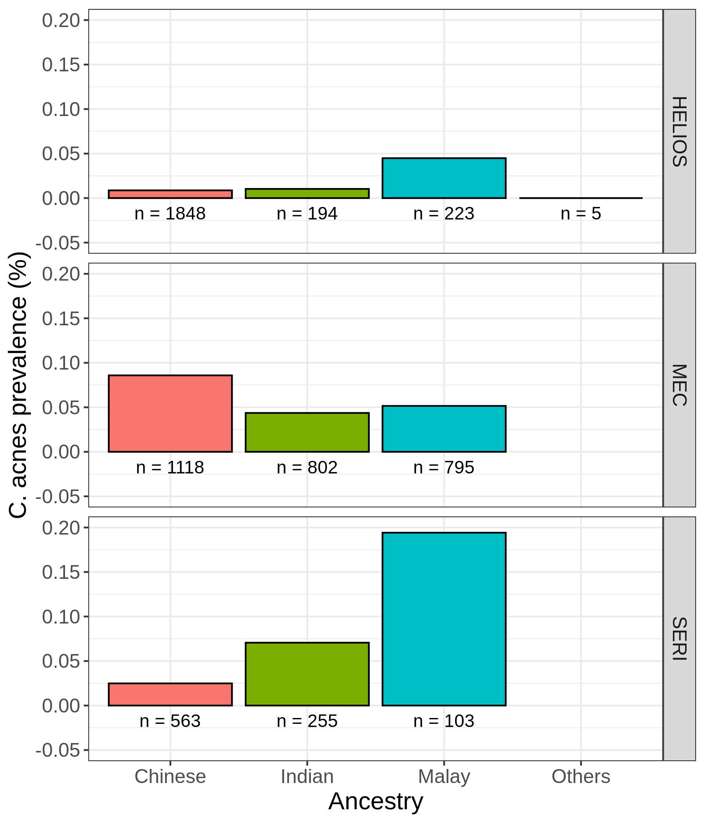
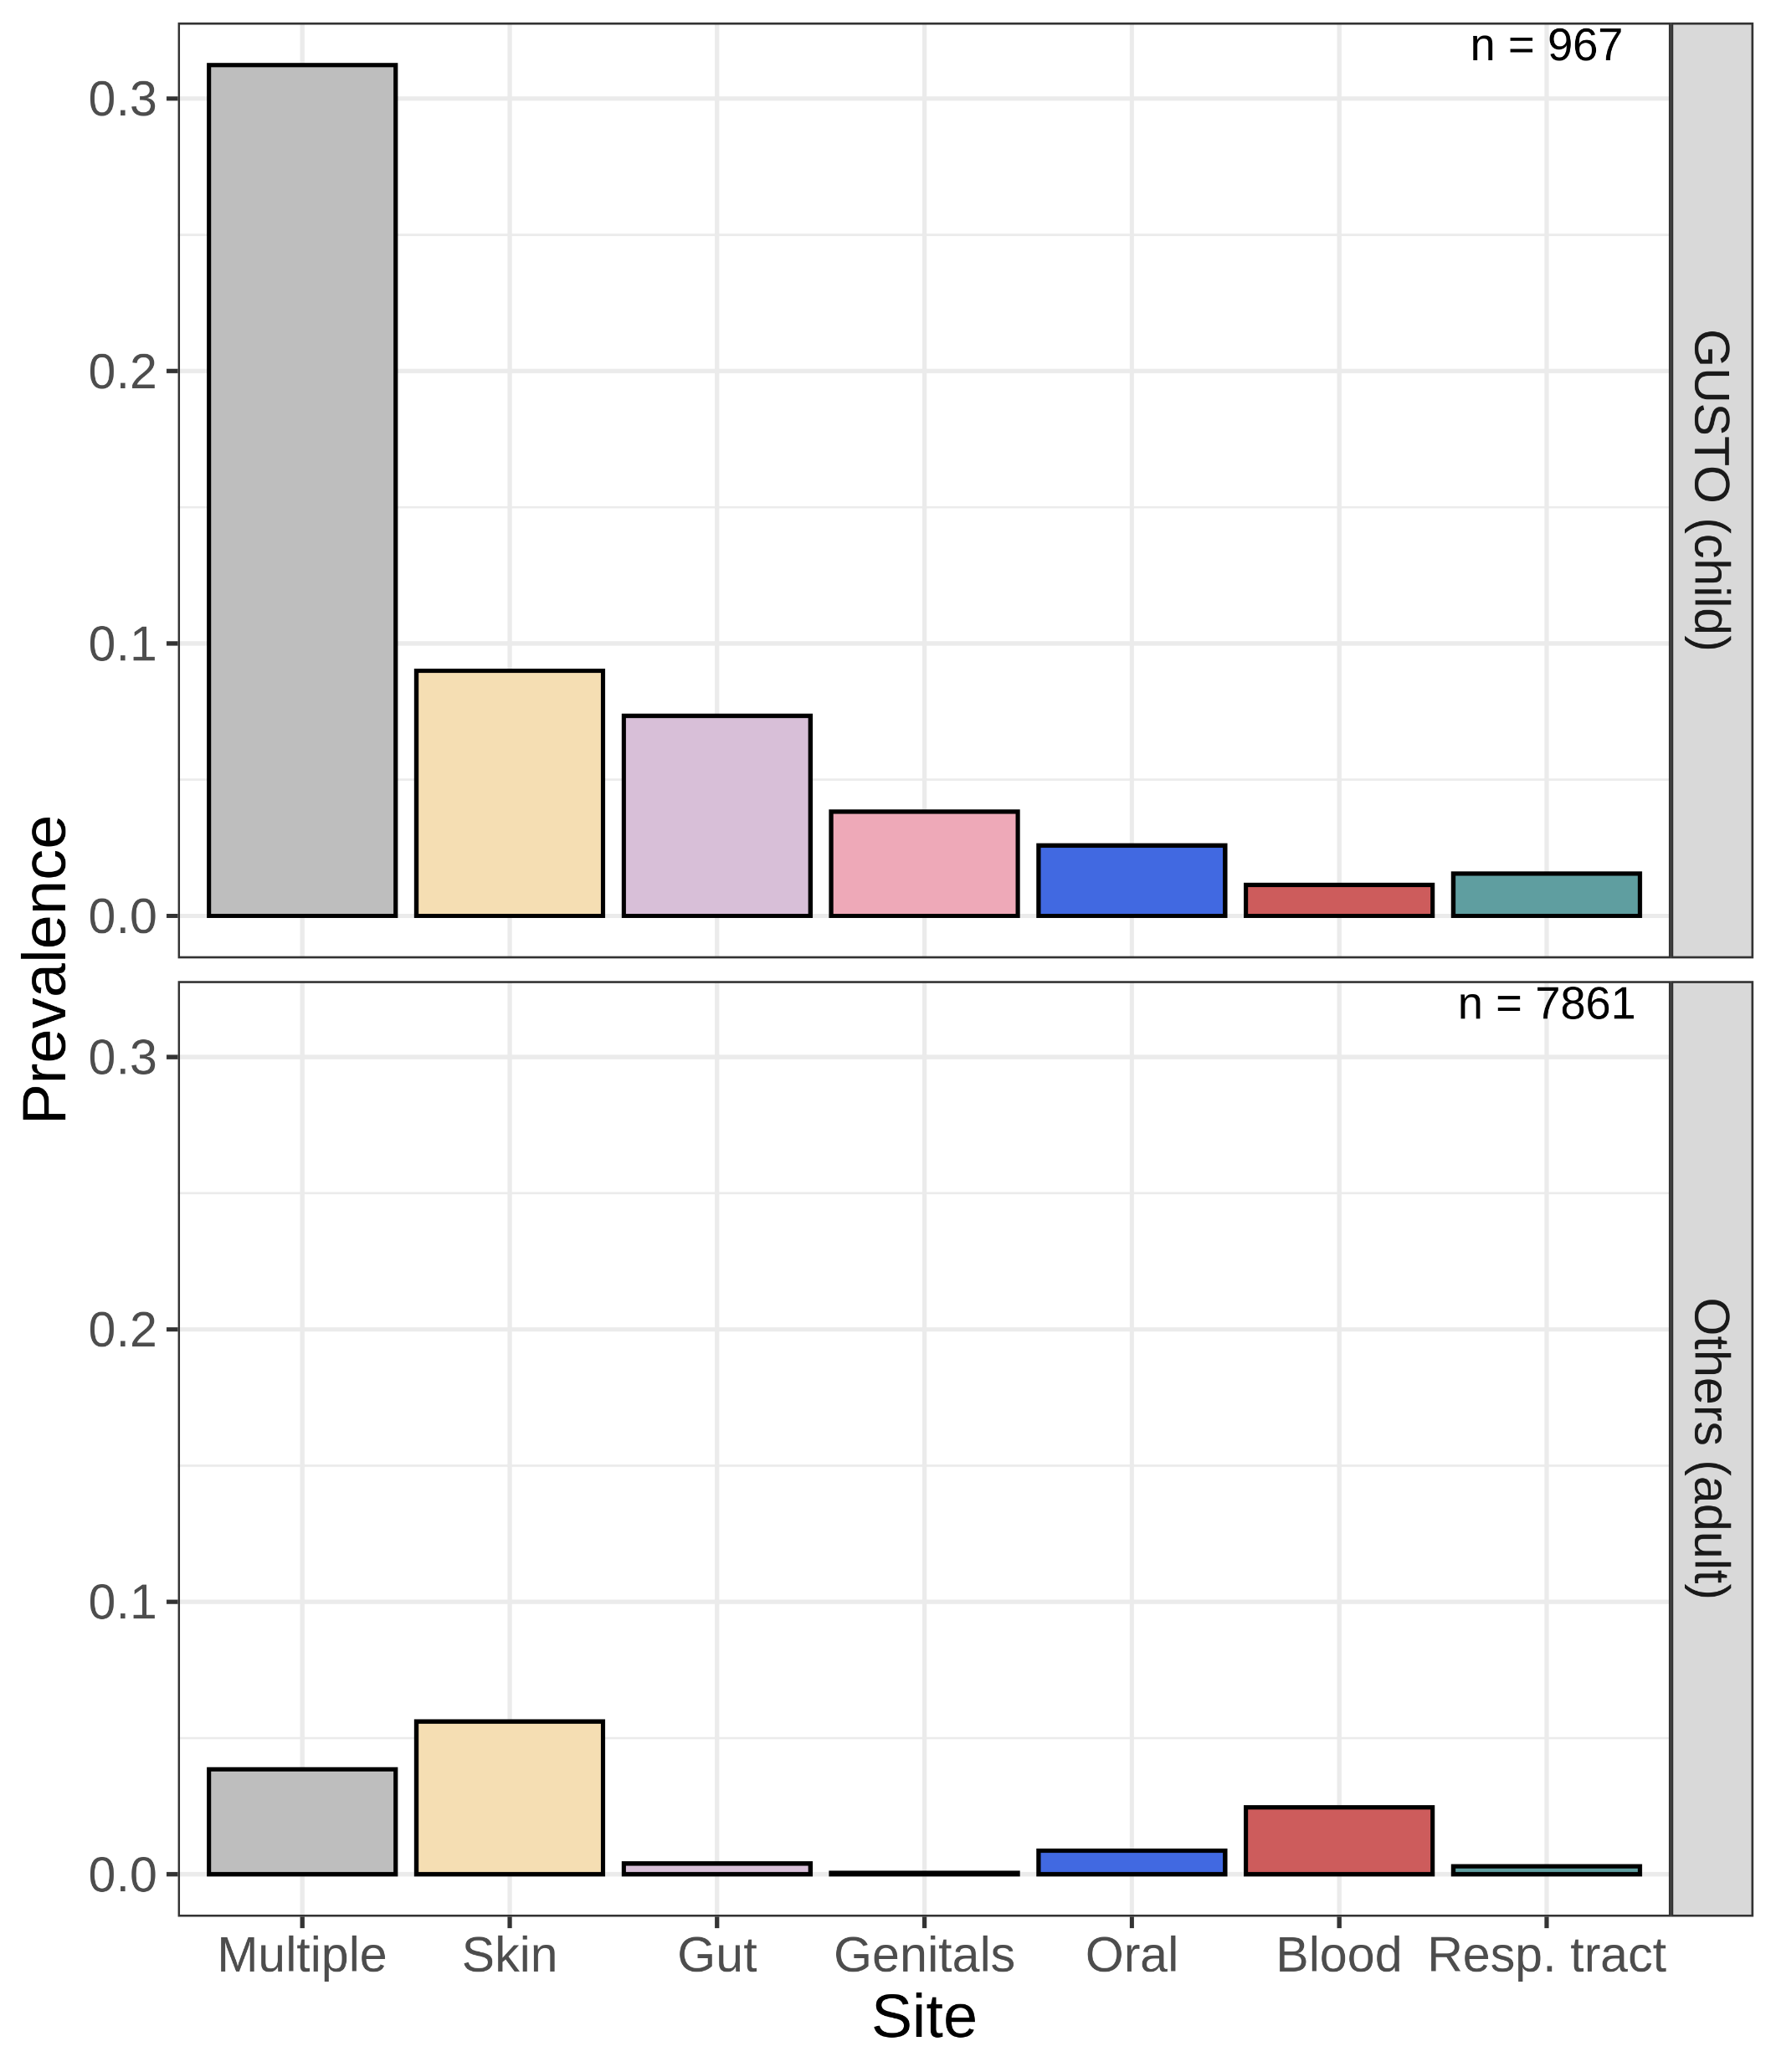
a
b
c
Notes:
Figure 4
Check paraburkholderia
Check bias of each column with cohorts
Substratify species

Slide 10
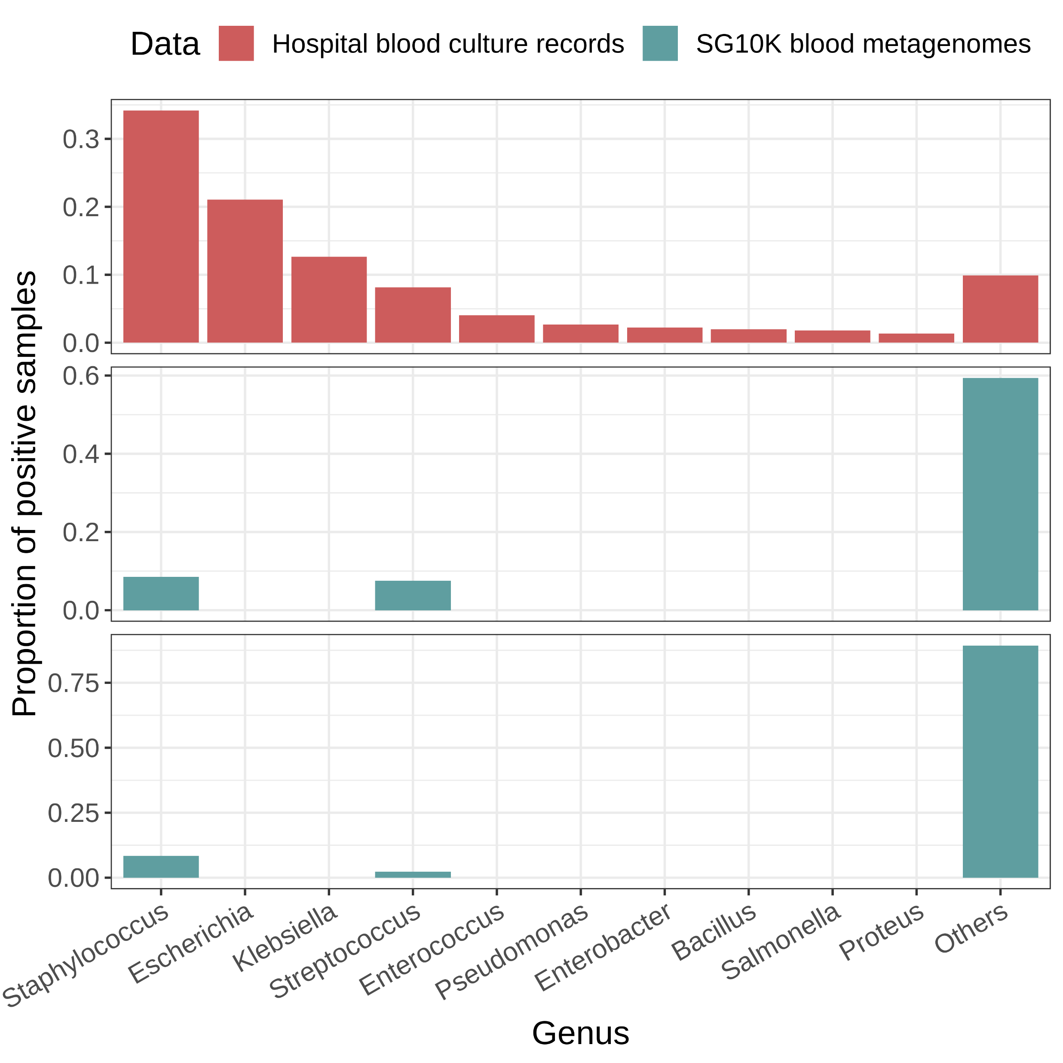
a
Prop. of positive cultures
b
Prop. of microbes detected
c
Prop. of non-contaminant species

Slide 11
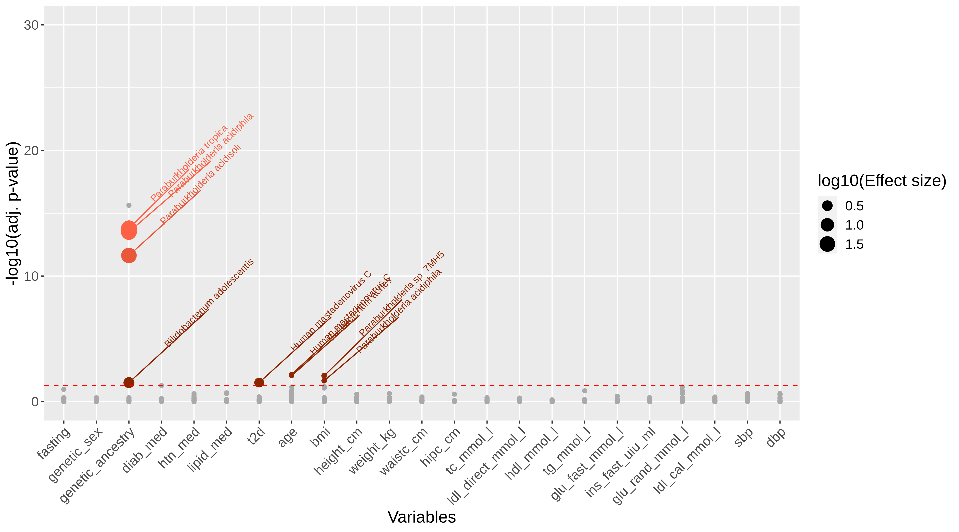
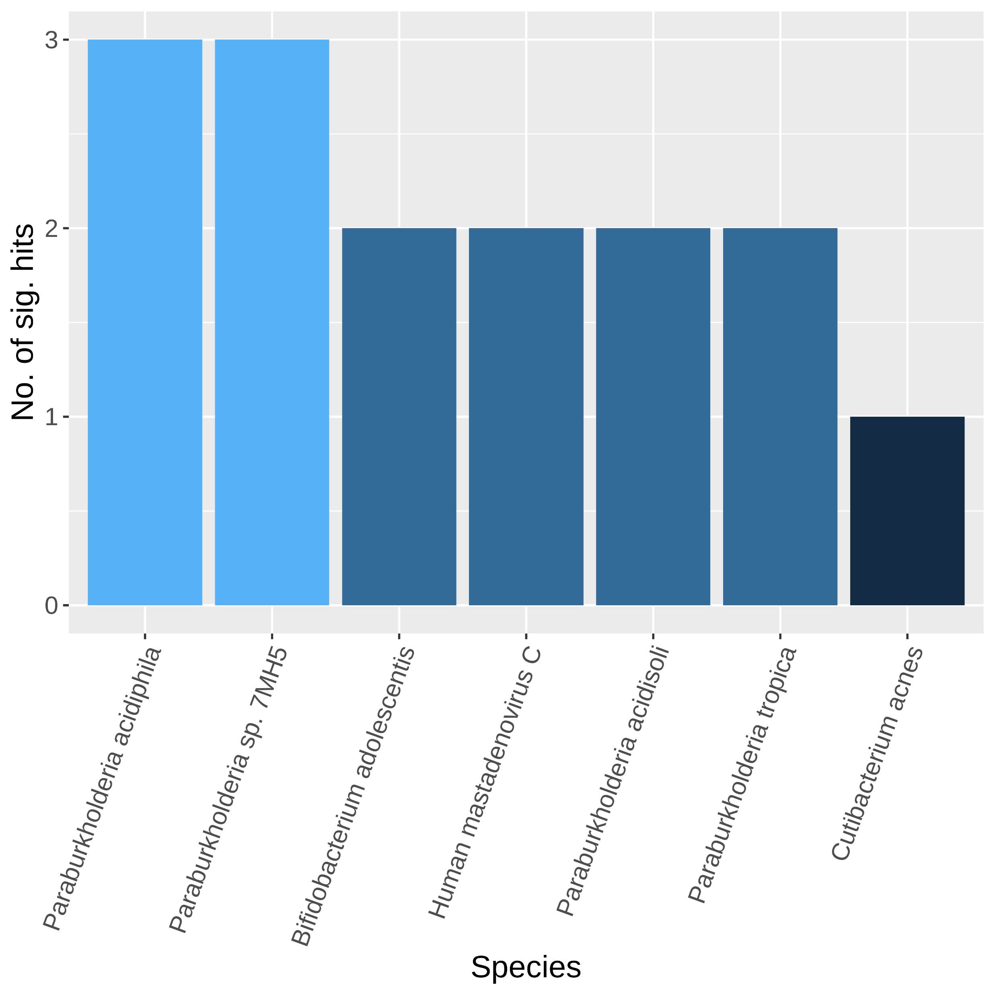
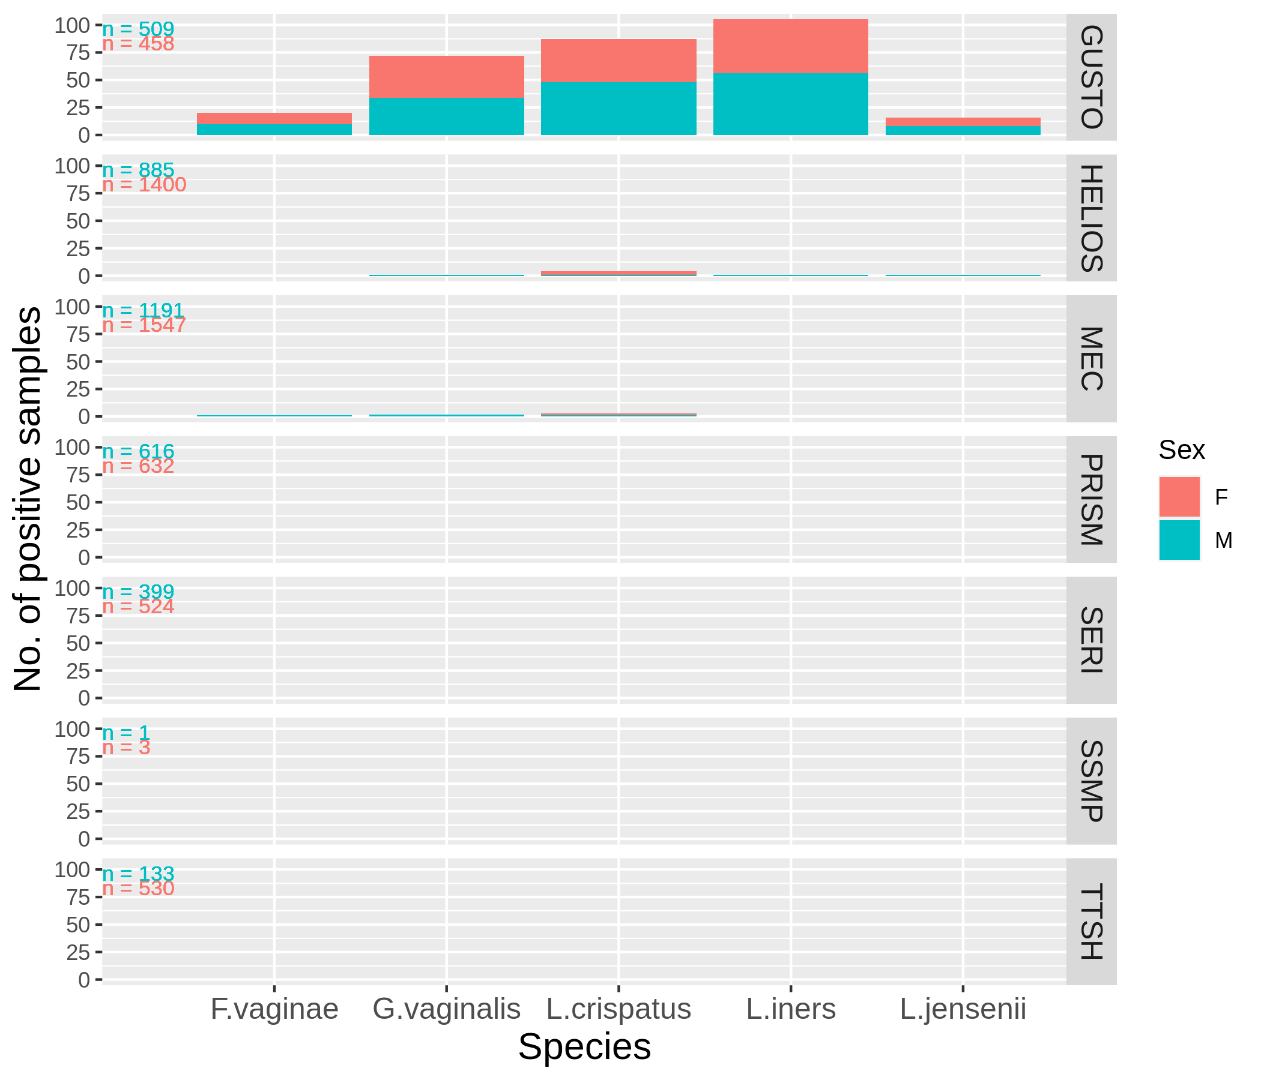
Effect of host phenotype
(a)
Presence of species, S
$ln⁡(odds({Presence}_{S}))=β_{0}+α_{cohort}+ γ_{variable}$ $+$ ε
Effect of cohort as covariate
(b)
(c)
Notes:
Figure 4
Check paraburkholderia
Check bias of each column with cohorts
Substratify species

Slide 12
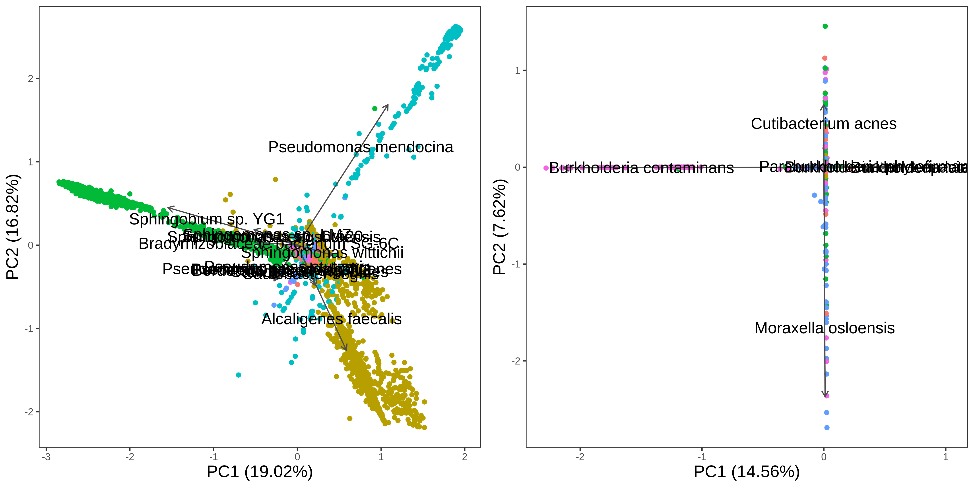
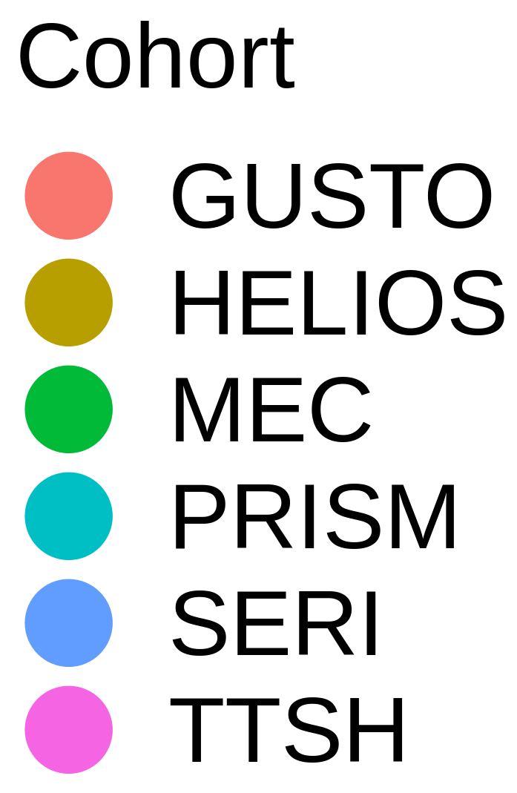
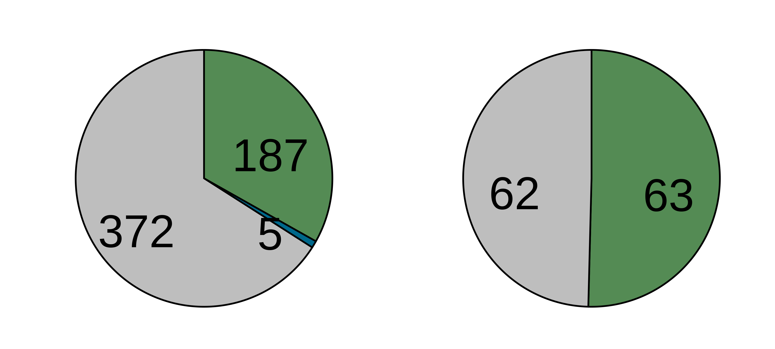



Before decontamination
After decontamination
(a)
(b)
(c)
(d)

Slide 13


5199 species
(a)
Pre-processed Fastqs (n = 9706)
Kraken2 classification
Apply abundance thresholds
564 species
(b)
Contaminant
Non-contaminant
Filter 1
> 2-fold
Differential prevalence
478 species
(c)
Filter 2
Correlation
434 species
Filter 4
Filter 3
Downstream analyses
Max read count filter
Batch filter
176 species
125 species

Slide 14








(a)
Pre-processed fastqs (n = 9706)
Kraken2 classification
Apply abundance thresholds
5199 species
564 species
Filter 1
Filter 2
Filter 3
Filter 4
Differential prevalence
Correlation
Batch filter
Max read count filter
Downstream analyses
478 species
434 species
176 species
125 species
(b)
Contaminant
Non-contaminant
(c)
> 2-fold
Before decontamination
After decontamination
(d)
(e)
(f)
(g)

Slide 15












(a)
Non-contaminants
F. nucleatum
M. osloensis
M. osloensis
N. subflava
H. parainfluenzae
F. vaginae
S. epidermidis
L. crispatus
A. baumannii
N. flavescens
(b)
Contaminants
A. xylosoxidans
P. mendocina
A. faecalis
Notes:
Figure 3 GROUPED
Median smoothing
Multiplot this (2x2)
We have helios skin data

Slide 16




Notes:
Figure 2
Check blood transfusion literature
Max. number of cells for contaminants vs. nc
Compare ranks of BC records with our ranks
Add average relative abundance

Slide 17

a
b
All species
n = 8828
c
n = 8828
Non-contaminants
d
e
Notes:
Figure 2

